Slide 1
Chapter 4 Selections
CPIT 110 (Problem-Solving and Programming)
Introduction to Programming Using Python, By: Y. Daniel Liang
Notes:
By: Ahmad Tayeb (@ahmad_tayeb)
https://ajtayeb.kau.edu.sa
Last Update: 29/8/2020
Version 2.0
Textbook:
Introduction to Programming Using Python, By: Y. Daniel Liang

Slide 2
Sections
4.1. Motivations
4.2. Boolean Types, Values, and Expressions
4.3. Generating Random Numbers
4.4. if Statements
4.6. Two-Way if-else Statements
4.7. Nested if and Multi-Way if-elif-else Statements
4.8. Common Errors in Selection Statements
4.9. Case Study: Computing Body Mass Index
4.11. Logical Operators
4.12. Case Study: Determining Leap Years
4.13. Case Study: Lottery
4.14. Conditional Expressions
4.15. Operator Precedence and Associativity
Debugging
Programs Check Points Labs

Slide 3
Programs
Python Online IDE
Program 1: Math Learning Tool
Program 2: Simple if Demo
Program 3: Improved Math Learning Tool
Program 4: Chinese Zodiac
Program 5: Computing BMI
Program 6: Test Boolean Operators
Program 7: Leap Year
Program 8: Lottery

Slide 4
Check Points
Section 4.3
#1
#2
#3
#4
Section 4.4
#5
Section 4.6
#6
#7
Section 4.7
#8
#9
#10
Section 4.8
#11
#12
#13
Section 4.11
#14
#15
#16
#17
#18
#19
#20
#21
Section 4.14
#22
#23
#24
#25
#26
#27
Section 4.15
#28
#29

Slide 5
Objectives
To write Boolean expressions by using comparison operators (4.2).
To generate random numbers by using the random.randint(a, b) or random.random() functions (4.3).
To program with Boolean expressions (AdditionQuiz) (4.3).
To implement selection control by using one-way if statements (4.4)
To implement selection control by using two-way if .. else statements (4.6).
To implement selection control with nested if ... elif ... else statements (4.7).
To avoid common errors in if statements (4.8).
To program with selection statements (4.9).
To combine conditions by using logical operators (and, or, and not) (4.11).
To use selection statements with combined conditions (LeapYear, Lottery) (4.12 – 4.13).
To write expressions that use the conditional expressions (4.14).
To understand the rules governing operator precedence and associativity (4.15).

Slide 6
4.1. Motivations

Slide 7
Motivations
Consider this problem from Chapter 2:
LISTING 2.2 ComputeAreaWithConsoleInput.py
1
2
3
4
5
6
7
8
# Prompt the user to enter a radius
radius = eval(input("Enter a value for radius: "))
# Compute area
area = radius * radius * 3.14159
# Display results
print("The area for the circle of radius " , radius , " is " , area)
Run
4.1
Notes:
# Prompt the user to enter a radius
radius = eval(input("Enter a value for radius: "))
# Compute area
area = radius * radius * 3.14159
# Display results
print("The area for the circle of radius " , radius , " is " , area)

Slide 8
Motivations
What happens if the user inputs a negative value for radius?
The program would print an invalid result.
If the radius is negative, you don't want the program to compute the area.
How can you deal with this situation?
4.1

Slide 9
Motivations
Python provides selection statements, which allow you to choose actions based on certain conditions.
For example, the following selection statement could be used in the previous program:
ModifiedComputeAreaWithConsoleInput.py
1
2
3
4
5
6
7
8
9
10
11
# Prompt the user to enter a radius
radius = eval(input("Enter a value for radius: "))
if radius < 0:
# radius is negative, so print an error message
print("Incorrect input")
else:
# Compute area
area = radius * radius * 3.14159
# Display results
print("The area for the circle of radius " , radius , " is " , area)
Run
4.1
Notes:
# Prompt the user to enter a radius
radius = eval(input("Enter a value for radius: "))
if radius < 0:
# radius is negative, so print an error message
print("Incorrect input")
else:
# Compute area
area = radius * radius * 3.14159
# Display results
print("The area for the circle of radius " , radius , " is " , area)

Slide 10
Motivations
ModifiedComputeAreaWithConsoleInput.py
1
2
3
4
5
6
7
8
9
10
11
# Prompt the user to enter a radius
radius = eval(input("Enter a value for radius: "))
if radius < 0:
# radius is negative, so print an error message
print("Incorrect input")
else:
# Compute area
area = radius * radius * 3.14159
# Display results
print("The area for the circle of radius " , radius , " is " , area)
Run
Enter a value for radius: -5 <Enter>
Incorrect input
Enter a value for radius: 0 <Enter>
The area for the circle of radius 0 is 0.0
Enter a value for radius: 5<Enter>
The area for the circle of radius 5 is 78.53975
4.1
Notes:
# Prompt the user to enter a radius
radius = eval(input("Enter a value for radius: "))
if radius < 0:
# radius is negative, so print an error message
print("Incorrect input")
else:
# Compute area
area = radius * radius * 3.14159
# Display results
print("The area for the circle of radius " , radius , " is " , area)

Slide 11
Motivations
Selection statements use conditions to test if something is true or false.
These conditions are known as Boolean expressions.
A Boolean expression is an expression that evaluates to a Boolean value (True or False).
This chapter introduces Boolean types, values, comparison operators, and expressions.
4.1

Slide 12
4.2. Boolean Types, Values, and Expressions
Boolean Data Types
Relational Operators
Boolean Variables
Convert Boolean Value to Integer
Convert Numeric Value to Boolean
Puzzle

Slide 13
Boolean Data Types
Often in a program you need to compare two values, such as whether x is greater than y.
Or if an inputted value, such as radius, is less than zero.
There are six comparison operators (also known as relational operators) that can be used to compare two values. The result of the comparison is a Boolean value: True or False.
For example:
1
2
3
4
x = 10 > 20
y = 10 < 20
print ("x =", x) # output: False
print ("y =", y) # output: True
x = False
y = True
4.2
Notes:
x = 10 > 20
y = 10 < 20
print ("x =", x) # output: False
print ("y =", y) # output: True

Slide 14
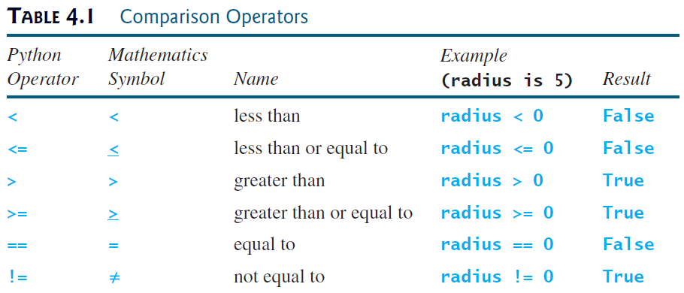
Relational Operators
4.2

Slide 15
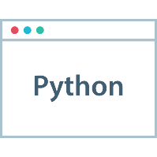
Caution
The equal to comparison operator is two equal signs (==), not a single equal sign (=). The latter symbol is for assignment.
>>> 20 == 30
False
>>> 50 == 50
True
>>> 50.0 == 50
True
>>> 50 = 30
SyntaxError: can't assign to literal
>>> 60.0001 == 60
False
4.2
Notes:
20 == 30
50 == 50
50.0 == 50
50 = 30
60.0001 == 60

Slide 16
Boolean Variables
A variable that holds a Boolean value is known as a Boolean variable.
The Boolean data type is used to represent Boolean values (True or False).
A Boolean variable can hold one of the two values: True or False.
For example, the following statement assigns the value True to the variable lightsOn:
True and False are literals, just like a number such as 10. They are reserved words and cannot be used as identifiers in a program.
lightsOn = True
4.2
Notes:
lightsOn = True

Slide 17
Convert Boolean Value to Integer
Internally, Python uses 1 to represent True and 0 for False.
You can use the int function to convert a Boolean value to an integer.
>>> int(True)
1
>>> int(False)
0
>>> print(int(True))
1
>>> print(int(20 > 50))
0
>>> print(int(True == False))
0
>>> print(int(20 * 2 > 30))
1
4.2
Notes:
int(True)
int(False)
print(int(True))
print(int(20 > 50))
print(int(True == False))
print(int(20 * 2 > 30))

Slide 18
Convert Numeric Value to Boolean
You can also use the bool function to convert a numeric value to a Boolean value.
The function returns False if the value is 0; otherwise, it always returns True.
>>> bool(1)
True
>>> bool(0)
False
>>> bool(15)
True
>>> bool(-20)
True
>>> bool(10 + 10 - 20)
False
4.2
Notes:
bool(1)
bool(0)
bool(15)
bool(-20)
bool(10 + 10 - 20)

Slide 19
Puzzle
What is the output of the following script?
1
2
3
4
5
6
7
8
x = int(True) + int(True) + int(int(True) - int(True))
y = int(True) * int(bool(50) * 3)
r = x + y
print("x = ", x)
print("y = ", y)
print("r = ", r)
print("bool(r) = ", bool(r))
print("bool(r - r) = ", bool(r - r))
x = 2
y = 3
r = 5
bool(r) = True
bool(r - r) = False
4.2
Notes:
x = int(True) + int(True) + int(int(True) - int(True))
y = int(True) * int(bool(50) * 3)
r = x + y
print("x = ", x)
print("y = ", y)
print("r = ", r)
print("bool(r) = ", bool(r))
print("bool(r - r) = ", bool(r - r))

Slide 20
4.3. Generating Random Numbers
Generating Random Integer Numbers
Program 1: Math Learning Tool
randrange function
Generating Random Float Numbers
Check Point #1 - #4

Slide 21
Generating Random Integer Numbers randint function
To generate a random number, you can use the randint(a, b) function in the random module.
This function returns a random integer between a and b, inclusively.
To obtain a random integer between 0 and 9, use randint(0, 9):
1
2
3
4
import random
x = random.randint(0, 9)
# x could be 0,1,2,3,4,5,6,7,8, or 9
print(x)
x = 2
x = 9
x = 7
x = 3
4.3
Notes:
import random
x = random.randint(0, 9)
# x could be 0,1,2,3,4,5,6,7,8, or 9
print(x)

Slide 22
Math Learning Tool Program 1
Write a program that helps a first-grader practice addition. The program should randomly generate two single-digit integers and should then ask the user for the answer. The program will then display a message stating if the answer is true or false.
What is 9 + 4? 12 <Enter>
9 + 4 = 12 is False
What is 3 + 1? 4 <Enter>
3 + 1 = 4 is True
4.3

Slide 23
Math Learning Tool Phase 1: Problem-solving
What does “single-digit integers” mean?
0 - 9
1-digit (single) integer → [0 - 9]
1
2
import random
number = random.randint(0, 9)
0 – 9 | 0 – 9
2-digit integer → [10 - 99]
1
2
import random
number = random.randint(10, 99)
0 – 9 | 0 – 9 | 0 – 9
3-digit integer → [100 - 999]
1
2
import random
number = random.randint(100, 999)
4.3
Notes:
# 0 – 9
import random
number = random.randint(0, 9)
# 10 – 99
import random
number = random.randint(10, 99)
# 100 – 999
import random
number = random.randint(100, 999)

Slide 24
Math Learning Tool Phase 1: Problem-solving
Design your algorithm:
Generate two single-digit integers for number1 and number2.
Use randint(0, 9)
Example: number1 = 2 and number2 = 6
Ask the user to answer a question
Example: “What is 2 + 6 ?”
Print whether the answer is true or false
4.3

Slide 25
Math Learning Tool Phase 2: Implementation
LISTING 4.1 AdditionQuiz.py
1
2
3
4
5
6
7
8
9
10
11
12
13
import random
# Generate random numbers
number1 = random.randint(0, 9)
number2 = random.randint(0, 9)
# Prompt the user to enter an answer
answer = eval(input("What is " + str(number1) + " + "
+ str(number2) + "? "))
# Display result
print(number1, "+", number2, "=", answer,
"is", number1 + number2 == answer)
Run
What is 1 + 7? 8 <Enter>
1 + 7 = 8 is True
What is 4 + 8? 9 <Enter>
4 + 8 = 9 is False
4.3
Notes:
import random
# Generate random numbers
number1 = random.randint(0, 9)
number2 = random.randint(0, 9)
# Prompt the user to enter an answer
answer = eval(input("What is " + str(number1) + " + "
+ str(number2) + "? "))
# Display result
print(number1, "+", number2, "=", answer,
"is", number1 + number2 == answer)

Slide 26
Math Learning Tool Trace The Program Execution
What is 4 + 8? 9 <Enter>
4 + 8 = 9 is False
4.3

Slide 27
Math Learning Tool Discussion
The program uses the randint function defined in the random module.
The import statement imports the module (line 1).
Lines 4-5 generate two numbers, number1 and number2.
Line 8 obtains an answer from the user.
The answer is graded in line 12 using a Boolean expression number1 + number2 == answer.
4.3

Slide 28
randrange function
Python also provides another function, randrange(a, b), for generating a random integer between a and b – 1, which is equivalent to randint(a, b – 1).
For example, randrange(0, 10) and randint(0, 9) are the same.
Since randint is more intuitive, the book generally uses randint in the examples.
>>> import random
>>> random.randrange(1, 3) # the value could be: 1 or 2
1
>>> random.randint(1, 3) # the value could be: 1, 2 or 3
2
>>> random.randint(0, 1) # the value could be: 0 or 1
1
>>> random.randrange(0, 1) # This will always be 0
0
4.3
Notes:
import random
random.randrange(1, 3) # the value could be: 1 or 2
random.randint(1, 3) # the value could be: 1, 2 or 3
random.randint(0, 1) # the value could be: 0 or 1
random.randrange(0, 1) # This will always be 0

Slide 29
Generating Random Float Numbers random function
You can also use the random() function to generate a random float r such that $0≤r<1$
For example:
Note: the random() function returns a random float number between 0.0 and 1.0 (excluding 1.0).
>>> import random
>>> random.random()
0.3362800598715141
>>> random.random()
0.886713208073315
>>> random.random()
0.9735731618649538
4.3
Notes:
import random
random.random()
random.random()
random.random()

Slide 30
Check Point #1
How you can generate a float number with n-digit before the decimal point?
We can do that by multiplying the generated number with ${10}^{n}$. For example:
Formula:
>>> import random
>>> random.random() * 10 ** 1 # 1-digit float number
8.573088600232266
>>> random.random() * 10 ** 2 # 2-digits float number
99.56489589285628
>>> random.random() * 10 ** 3 # 3-digit float number
428.6688384440885
number = random.random() * 10 ** n
n for the number of the digits before the decimal point
4.3
Notes:
import random
random.random() * 10 ** 1 # 1-digit float number
random.random() * 10 ** 2 # 2-digits float number
random.random() * 10 ** 3 # 3-digit float number

Slide 31
Check Point #2
How you can generate a float number with n-digit before the decimal point and d-digit after the decimal point?
We can do that by using the round function as the following:
Formula:
>>> import random
>>> round(random.random() * 10 ** 1, 2)
7.66
>>> round(random.random() * 10 ** 2, 2)
79.95
>>> round(random.random() * 10 ** 4, 3)
2969.055
number = round(random.random() * 10 ** n, d)
n for the number of the digits before the decimal point d for the number of the digits after the decimal point
4.3
Notes:
import random
round(random.random() * 10 ** 1, 2)
round(random.random() * 10 ** 2, 2)
round(random.random() * 10 ** 4, 3)

Slide 32
Check Point #3
How you can generate a random float number that is equal or greater than a and less than b ($a ≤number <b$).
We can do that as the following:
Examples:
number = a + (random.random() * (b - a))
>>> import random
>>> a, b = 1, 3
>>> a + (random.random() * (b - a)) # a = 1, b = 3
1.6393718672389215
>>> a, b = 10, 20
>>> a + (random.random() * (b - a)) # a = 10, b = 20
15.046056155663972
4.3
Notes:
import random
a, b = 1, 3
a + (random.random() * (b - a)) # a = 1, b = 3
a, b = 10, 20
a + (random.random() * (b - a)) # a = 10, b = 20

Slide 33
Check Point #4
How do you generate a random integer i such that $0≤i<20$ ?
How do you generate a random integer i such that $10≤i≤50$?
1
2
3
4
import random
i = random.randint(0, 19)
# Or ->
i = random.randrange(0, 20)
1
2
3
4
import random
i = random.randint(10, 50)
# Or ->
i = random.randrange(10, 51)
4.3
Notes:
# Q
import random
i = random.randint(0, 19)
# Or ->
i = random.randrange(0, 20)
# A
import random
i = random.randint(10, 50)
# Or ->
i = random.randrange(10, 51)

Slide 34
4.4. if Statements
Types of Selection Statements
One-way if Statements
if Block
Program 2: Simple if Demo
Check Point #5

Slide 35
Types of Selection Statements
The preceding program (Program 1) displays a message such as 6 + 2 = 7 is False. If you wish the message to be 6 + 2 = 7 is incorrect, you have to use a selection statement to make this minor change.
Python has several types of selection statements:
one-way if statements
two-way if-else statements
nested if statements
multi-way if-elif-else statements
conditional expressions
4.4

Slide 36
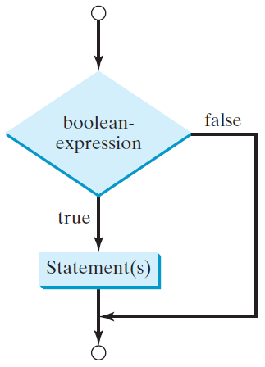
One-way if Statements
A one-way if statement executes an action if and only if the condition is true.
The syntax for a one-way if statement is:
The flowchart to the right demonstrates the syntax of an if statement.
Example:
if boolean-expression: statement(s)
1
2
3
4
lightOn = True
if lightOn:
print("Light ON")
4.4
Notes:
lightOn = True
if lightOn:
print("Light ON")

Slide 37
Note
Also, the following syntax is valid for one-way if statement with a one statement on one line:
Example:
It is equivalent to:
if boolean-expression: statement
1
2
3
lightOn = True
if lightOn: print("Light ON")
if lightOn == False: print("Light OFF")
1
2
3
4
5
6
7
lightOn = True
if lightOn:
print("Light ON")
if lightOn == False:
print("Light OFF")
4.4
Notes:
lightOn = True
if lightOn: print("Light ON")
if lightOn == False: print("Light OFF")
# =
lightOn = True
if lightOn:
print("Light ON")
if lightOn == False:
print("Light OFF")

Slide 38
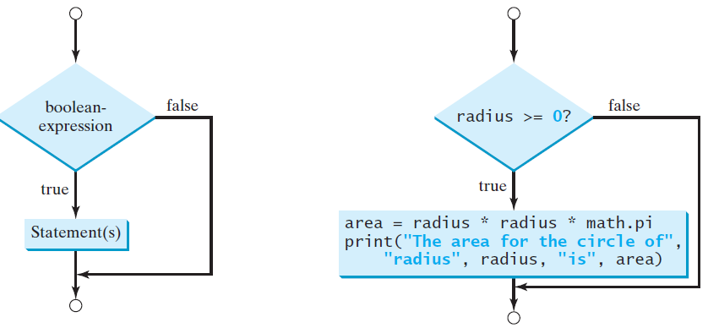
Remember
A flowchart is a diagram that describes an algorithm or process, showing the steps as boxes of various kinds, and their order by connecting these with arrows.
Process operations are represented in these boxes, and arrows connecting them show flow of control.
A diamond box is used to denote a Boolean condition and a rectangle box is for representing statements.
4.4

Slide 39
if Block
If the boolean-expression evaluates to true, the statements in the if block are executed.
The if block contains the statements indented after the if statement.
For example:
If the value of radius is greater than or equal to 0, then the area is computed and the result is displayed; otherwise, these statements in the block are not executed.
if radius >= 0:
area = radius * radius * math.pi
print("The area for the circle of radius", radius, "is", area)
4.4
Notes:
if radius >= 0:
area = radius * radius * math.pi
print("The area for the circle of radius", radius, "is", area)

Slide 40
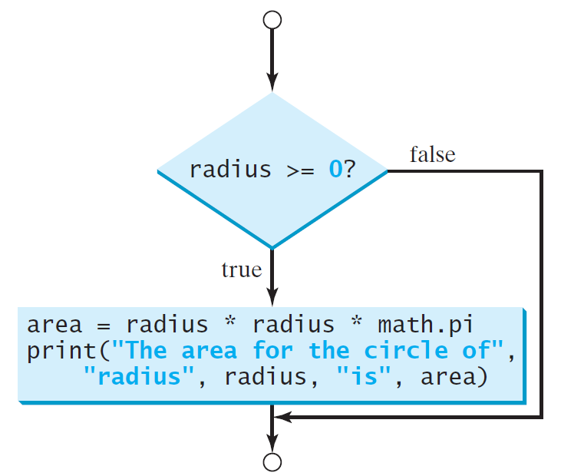
if Block
if radius >= 0:
area = radius * radius * math.pi
print("The area for the circle of radius", radius, "is", area)
4.4
Notes:
if radius >= 0:
area = radius * radius * math.pi
print("The area for the circle of radius", radius, "is", area)

Slide 41
Note
The statements in the if block must be indented in the lines after the if line and each statement must be indented using the same number of spaces.
For example, the following code is wrong, because the print statement in line 3 is not indented using the same number of spaces as the statement for computing area in line 2.
1
2
3
if radius >= 0:
area = radius * radius * math.pi
print("The area for the circle of radius", radius, "is", area)
4.4
Notes:
if radius >= 0:
area = radius * radius * math.pi
print("The area for the circle of radius", radius, "is", area)

Slide 42
Note
1
2
if i > 0:
print("i is positive.")
1
2
if i > 0:
print("i is positive.")
(A) Wrong ❌
(B) Correct ✔
1
2
if i > 0: print("Positive")
print("Not in the if block")
1
2
if i > 0: print("Positive")
print("Not in the if block")
(C) Wrong ❌
(D) Correct ✔
1
2
3
if i > 0:
print("Positive") print("Not in the if block")
1
2
3
if i > 0:
print("Positive") print("Not in the if block")
(E) Wrong ❌
(F) Correct ✔
1
2
if i > 0 # missing :
print("i is positive.")
1
2
if i > 0 :
print("i is positive.")
(G) Wrong ❌
(H) Correct ✔
4.4
Notes:
# A
if i > 0:
print(“i is positive.")
# B
if i > 0:
print(“i is positive.")
# C
if i > 0: print("Positive")
print("Not in the if block")
# D
if i > 0: print("Positive")
print("Not in the if block")
# E
if i > 0:
print("Positive") print("Not in the if block")
# F
if i > 0:
print("Positive") print("Not in the if block")
# G
if i > 0 # missing :
print(“i is positive.")
# H
if i > 0 :
print(“i is positive.")

Slide 43
Simple if Demo Program 2
Write a program that prompts the user to enter an integer. If the number is a multiple of 5, the program displays the result HiFive. If the number is divisible by 2, the program displays HiEven.
Enter an integer: 4 <Enter>
HiEven
Enter an integer: 15 <Enter>
HiFive
Enter an integer: 30 <Enter>
HiFive
HiEven
4.4

Slide 44
Simple if Demo Phase 1: Problem-solving
Design your algorithm:
Prompt the user to enter an integer (number).
If number is a multiple of 5, print HiFive.
if (number % 5 == 0)
If number is divisible by 2, print HiEven.
if (number % 2 == 0)
4.4

Slide 45
Simple if Demo Phase 2: Implementation
LISTING 4.1 SimpleIfDemo.py
1
2
3
4
5
6
7
number = eval(input("Enter an integer: "))
if number % 5 == 0:
print("HiFive")
if number % 2 == 0:
print("HiEven")
Run
Enter an integer: 4 <Enter>
HiEven
Enter an integer: 15 <Enter>
HiFive
Enter an integer: 30 <Enter>
HiFive
HiEven
4.4
Notes:
number = eval(input("Enter an integer: "))
if number % 5 == 0:
print("HiFive")
if number % 2 == 0:
print("HiEven")

Slide 46
Check Point #5
Write an if statement that assigns 1 to x if y is greater than 0.
Write an if statement that increases pay by 3% if score is greater than 90.
1
2
if y > 0:
x = 1
1
2
if score > 90:
pay = pay + ( pay * (3 / 100) )
4.4
Notes:
#
if y > 0:
x = 1
#
if score > 90:
pay = pay + ( pay * (3 / 100) )

Slide 47
4.6. Two-Way if-else Statements
Program 3: Improved Math Learning Tool
Check Point #6 - #7

Slide 48
Two-way if-else Statement
A one-way if statement takes an action if the specified condition is True.
If the condition is False, nothing is done.
But what if you want to take one or more alternative actions when the condition is False?
Answer: you can use a two-way if-else statement.
The actions that a two-way if-else statement specifies differ based on whether the condition is True or False.
4.6

Slide 49
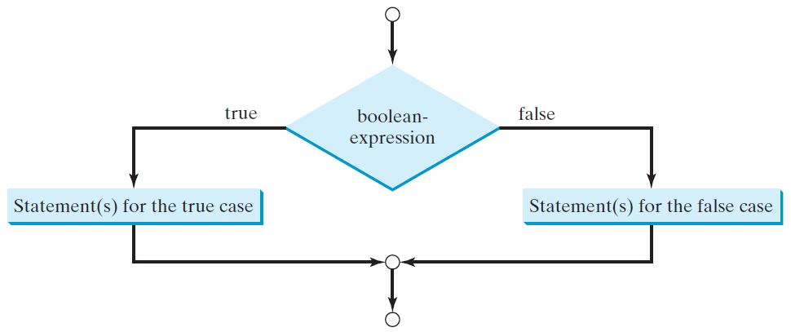
Two-way if-else Statement
Here is the syntax for a two-way if-else statement:
if boolean-expression: statement(s)-for-the-true-case else: statement(s)-for-the-false-case
4.6

Slide 50
Two-way if-else Statement
If the boolean-expression evaluates to True, the statement(s) for the True case are executed.
Else, the statement(s) for the False case are executed.
For example, consider the following code:
If radius >= 0 is True, area is computed and displayed.
if it is False, the message Negative input is displayed.
1
2
3
4
5
if radius >= 0:
area = radius * radius * math.pi
print("The area for the circle of radius", radius, "is", area)
else:
print("Negative input")
4.6
Notes:
if radius >= 0:
area = radius * radius * math.pi
print("The area for the circle of radius", radius, "is", area)
else:
print("Negative input")

Slide 51
Two-way if-else Statement
Another example: this one determines whether a number is even or odd, as follows:
1
2
3
4
if number % 2 == 0:
print(number, "is even.")
else:
print(number, "is odd.")
4.6
Notes:
if number % 2 == 0:
print(number, "is even.")
else:
print(number, "is odd.")

Slide 52
Note
The following syntax is valid for two way if-else statement with a one statement for the true case and a one statement for the false case.
Example:
if boolean-expression: statement-for-the-true-case else: statement-for-the-false-case
1
2
3
number = eval(input("Enter a number: "))
if number % 2 == 0: print(number, "is even.")
else: print(number, "is odd.")
4.6
Notes:
number = eval(input("Enter a number: "))
if number % 2 == 0: print(number, "is even.")
else: print(number, "is odd.")

Slide 53
Improved Math Learning Tool Program 3
Write a program that helps a first-grader practice subtraction. The program should randomly generate two single-digit integers, number1 and number2, with number1 >= number2 and should then ask the user for the answer. The program will then display a message stating if the answer is correct. If wrong, the program should display the correct answer.
What is 6 - 6? 0 <Enter>
You are correct!
What is 9 - 2? 5 <Enter>
Your answer is wrong.
9 - 2 is 7
4.6

Slide 54
Improved Math Learning Tool Phase 1: Problem-solving
Design your algorithm:
Generate two single-digit integers for number1 and number2.
Example: number1 = 6 and number2 = 2
If number1 < number2, swap number1 with number2.
Example: make number1 = 2 and number2 = 6
Ask the user to answer a question
Example: “What is 6 - 2 ?”
Print whether the answer is true or false
If the answer is false, print the correct answer
4.6

Slide 55
Improved Math Learning Tool Phase 2: Implementation
LISTING 4.4 SubtractionQuiz.py
1
2
3
4
5
6
7
8
9
10
11
12
13
14
15
16
17
18
19
20
import random
# 1. Generate two random single-digit integers
number1 = random.randint(0, 9)
number2 = random.randint(0, 9)
# 2. If number1 < number2, swap number1 with number2
if number1 < number2:
number1, number2 = number2, number1 # Simultaneous assignment
# 4. Prompt the student to answer "what is number1 - number2?“
answer = eval(input("What is " + str(number1) + " - " +
str(number2) + "? "))
# 4. Grade the answer and display the result
if number1 - number2 == answer:
print("You are correct!")
else:
print("Your answer is wrong.\n", number1, "-",
number2, "is", number1 - number2)
Run
4.6
Notes:
import random
# 1. Generate two random single-digit integers
number1 = random.randint(0, 9)
number2 = random.randint(0, 9)
# 2. If number1 < number2, swap number1 with number2
if number1 < number2:
number1, number2 = number2, number1 # Simultaneous assignment
# 4. Prompt the student to answer "what is number1 - number2?“
answer = eval(input("What is " + str(number1) + " - " +
str(number2) + "? "))
# 4. Grade the answer and display the result
if number1 - number2 == answer:
print("You are correct!")
else:
print("Your answer is wrong.\n", number1, "-",
number2, "is", number1 - number2)

Slide 56
Improved Math Learning Tool Trace The Program Execution
What is 9 - 2? 5 <Enter>
Your answer is wrong.
9 - 2 is 7
4.6

Slide 57
Check Point #6
Write an if statement that increases pay by 3% if score is greater than 90, otherwise it increases pay by 1%.
1
2
3
4
if score > 90:
pay = pay + ( pay * (3 / 100) )
else:
pay = pay + ( pay * (1 / 100) )
4.6
Notes:
if score > 90:
pay = pay + ( pay * (3 / 100) )
else:
pay = pay + ( pay * (1 / 100) )

Slide 58
Check Point #7
What is the printout of the code in (a) and (b) if number is 30 and 35, respectively?
1
2
3
4
if number % 2 == 0:
print(number, "is even.")
print(number, "is odd.")
1
2
3
4
if number % 2 == 0:
print(number, "is even.")
else:
print(number, "is odd.")
(a)
(b)
30 is even.
30 is odd.
30 is even.
35 is odd.
35 is odd.
4.6
Notes:
# A
if number % 2 == 0:
print(number, "is even.")
print(number, "is odd.")
# B
if number % 2 == 0:
print(number, "is even.")
else:
print(number, "is odd.")

Slide 59
4.7. Nested if and Multi-Way if-elif-else Statements
Nested if
Nested if and Multi-Way if-elif-else Statements
Trace if-elif-else Statement
Program 4: Chinese Zodiac
Check Point #8 - #10

Slide 60
Nested if
The statement in an if or if-else statement can be any legal Python statement.
Including another if or if-else statement.
The inner if statement is said to be nested inside the outer if statement.
Example:
The if j > k statement is nested inside the if i > k statement
1
2
3
4
5
if i > k:
if j > k:
print("i and j are greater than k")
else:
print("i is less than or equal to k")
4.7
Notes:
if i > k:
if j > k:
print("i and j are greater than k")
else:
print("i is less than or equal to k")

Slide 61
Nested if
More details:
The inner if statement can contain another if statement.
In fact, there is no limit to the depth of the nesting.
So what is the purpose?
The nested if statement can be used to implement multiple alternatives.
Consider the following example in the next slide, which prints a letter grade according to the final number grade.
4.7

Slide 62
Nested if and Multi-Way if-elif-else Statements
1
2
3
4
5
6
7
8
9
10
11
12
13
if score >= 90.0:
grade = 'A'
else:
if score >= 80.0:
grade = 'B'
else:
if score >= 70.0:
grade = 'C'
else:
if score >= 60.0:
grade = 'D'
else:
grade = 'F'
1
2
3
4
5
6
7
8
9
10
if score >= 90.0:
grade = 'A'
elif score >= 80.0:
grade = 'B'
elif score >= 70.0:
grade = 'C'
elif score >= 60.0:
grade = 'D'
else:
grade = 'F'
equivalent
This is better
(a)
(b)
While (a) works, the preferred format for multiple alternatives is shown in (b) using a multi-way if-elif-else statement.
This multi-way if-elif-else style avoids deep indentation and makes the program easier to read.
4.7
Notes:
# A
if score >= 90.0:
grade = 'A'
else:
if score >= 80.0:
grade = 'B'
else:
if score >= 70.0:
grade = 'C'
else:
if score >= 60.0:
grade = 'D'
else:
grade = 'F’
# B
if score >= 90.0:
grade = 'A'
elif score >= 80.0:
grade = 'B'
elif score >= 70.0:
grade = 'C'
elif score >= 60.0:
grade = 'D'
else:
grade = 'F'

Slide 63
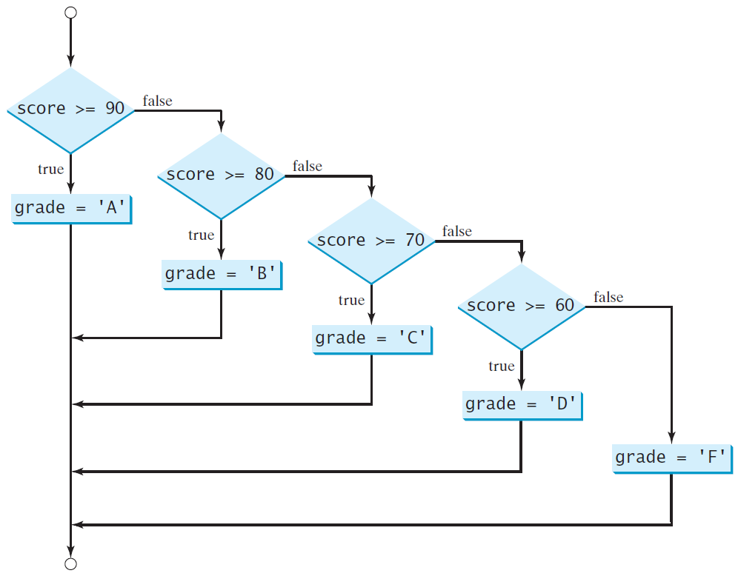
Nested if and Multi-Way if-elif-else Statements
4.7

Slide 64
Trace if-elif-else Statement
Suppose score is 70.0
1
2
3
4
5
6
7
8
9
10
11
if score >= 90.0:
grade = 'A'
elif score >= 80.0:
grade = 'B'
elif score >= 70.0:
grade = 'C'
elif score >= 60.0:
grade = 'D'
else:
grade = 'F'
The condition is False
4.7
Notes:
if score >= 90.0:
grade = 'A'
elif score >= 80.0:
grade = 'B'
elif score >= 70.0:
grade = 'C'
elif score >= 60.0:
grade = 'D'
else:
grade = 'F'

Slide 65
Trace if-elif-else Statement
Suppose score is 70.0
1
2
3
4
5
6
7
8
9
10
11
if score >= 90.0:
grade = 'A'
elif score >= 80.0:
grade = 'B'
elif score >= 70.0:
grade = 'C'
elif score >= 60.0:
grade = 'D'
else:
grade = 'F'
The condition is False
4.7
Notes:
if score >= 90.0:
grade = 'A'
elif score >= 80.0:
grade = 'B'
elif score >= 70.0:
grade = 'C'
elif score >= 60.0:
grade = 'D'
else:
grade = 'F'

Slide 66
Trace if-elif-else Statement
Suppose score is 70.0
1
2
3
4
5
6
7
8
9
10
11
if score >= 90.0:
grade = 'A'
elif score >= 80.0:
grade = 'B'
elif score >= 70.0:
grade = 'C'
elif score >= 60.0:
grade = 'D'
else:
grade = 'F'
The condition is True
4.7
Notes:
if score >= 90.0:
grade = 'A'
elif score >= 80.0:
grade = 'B'
elif score >= 70.0:
grade = 'C'
elif score >= 60.0:
grade = 'D'
else:
grade = 'F'

Slide 67
Trace if-elif-else Statement
Suppose score is 70.0
1
2
3
4
5
6
7
8
9
10
11
if score >= 90.0:
grade = 'A'
elif score >= 80.0:
grade = 'B'
elif score >= 70.0:
grade = 'C'
elif score >= 60.0:
grade = 'D'
else:
grade = 'F'
grade is C
4.7
Notes:
if score >= 90.0:
grade = 'A'
elif score >= 80.0:
grade = 'B'
elif score >= 70.0:
grade = 'C'
elif score >= 60.0:
grade = 'D'
else:
grade = 'F'

Slide 68
Trace if-elif-else Statement
Suppose score is 70.0
1
2
3
4
5
6
7
8
9
10
11
if score >= 90.0:
grade = 'A'
elif score >= 80.0:
grade = 'B'
elif score >= 70.0:
grade = 'C'
elif score >= 60.0:
grade = 'D'
else:
grade = 'F'
Exit the if statement
Note:
A condition is only tested when all the conditions that come before it are False.
4.7
Notes:
if score >= 90.0:
grade = 'A'
elif score >= 80.0:
grade = 'B'
elif score >= 70.0:
grade = 'C'
elif score >= 60.0:
grade = 'D'
else:
grade = 'F'

Slide 69
Chinese Zodiac Program 4
Write a program that will determine the Chinese Zodiac for a given year. Specifically, your program should prompt the user to enter a year and then determine the Zodiac and display the results.
The Chinese zodiac sign is based on a 12-year cycle, and each year in this cycle is represented by an animal: monkey, rooster, dog, pig, rat, ox, tiger, rabbit, dragon, snake, horse, and sheep.
Enter a year: 1963 <Enter>
rabbit
Enter a year: 1877 <Enter>
ox
4.7

Slide 70
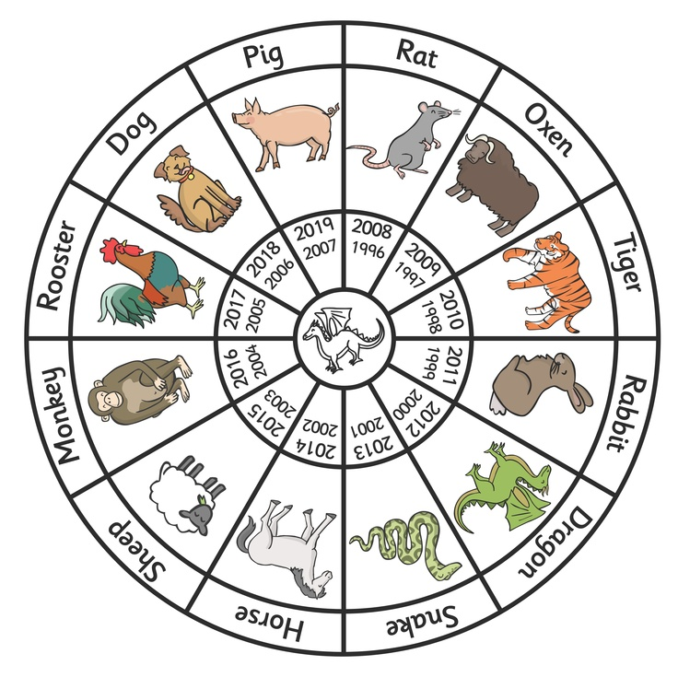
Chinese Zodiac Phase 1: Problem-solving
Zodiac is shown by graph below:
4.7

Slide 71
Chinese Zodiac Phase 1: Problem-solving
Design your algorithm:
Ask the user to enter the year
Determine the correct Zodiac year
zodiacYear = year % 12
Print the result (zodiacYear)
4.7

Slide 72
Chinese Zodiac Phase 2: Implementation
LISTING 4.5 ChineseZodiac.py
1
2
3
4
5
6
7
8
9
10
11
12
13
14
15
16
17
18
19
20
21
22
23
24
25
26
year = eval(input("Enter a year: "))
zodiacYear = year % 12
if zodiacYear == 0:
print("monkey")
elif zodiacYear == 1:
print("rooster")
elif zodiacYear == 2:
print("dog")
elif zodiacYear == 3:
print("pig")
elif zodiacYear == 4:
print("rat")
elif zodiacYear == 5:
print("ox")
elif zodiacYear == 6:
print("tiger")
elif zodiacYear == 7:
print("rabbit")
elif zodiacYear == 8:
print("dragon")
elif zodiacYear == 9:
print("snake")
elif zodiacYear == 10:
print("horse")
else:
print("sheep")
Run
Enter a year: 1963 <Enter>
rabbit
Enter a year: 1877 <Enter>
ox
4.7
Notes:
year = eval(input("Enter a year: "))
zodiacYear = year % 12
if zodiacYear == 0:
print("monkey")
elif zodiacYear == 1:
print("rooster")
elif zodiacYear == 2:
print("dog")
elif zodiacYear == 3:
print("pig")
elif zodiacYear == 4:
print("rat")
elif zodiacYear == 5:
print("ox")
elif zodiacYear == 6:
print("tiger")
elif zodiacYear == 7:
print("rabbit")
elif zodiacYear == 8:
print("dragon")
elif zodiacYear == 9:
print("snake")
elif zodiacYear == 10:
print("horse")
else:
print("sheep")

Slide 73
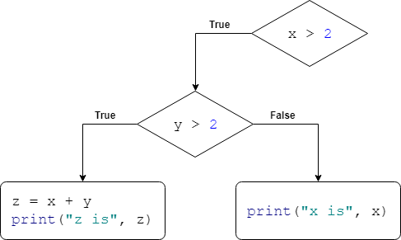
Check Point #8
Given the following code, show the output when:
x = 2 and y = 3
x = 3 and y = 2
x = 3 and y = 3
Empty
x is 3
z is 6
1
2
3
4
5
6
if x > 2:
if y > 2:
z = x + y
print("z is", z)
else:
print("x is", x)
4.7
Notes:
if x > 2:
if y > 2:
z = x + y
print("z is", z)
else:
print("x is", x)

Slide 74
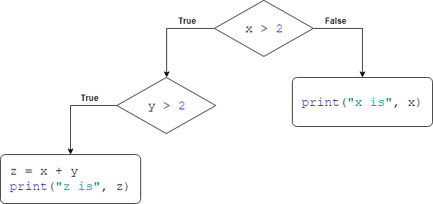
Check Point #9
Given the following code, show the output when:
x = 2 and y = 4
x = 3 and y = 2
x = 3 and y = 3
x is 2
Empty
z is 6
1
2
3
4
5
6
if x > 2:
if y > 2:
z = x + y
print("z is", z)
else:
print("x is", x)
4.7
Notes:
if x > 2:
if y > 2:
z = x + y
print("z is", z)
else:
print("x is", x)

Slide 75
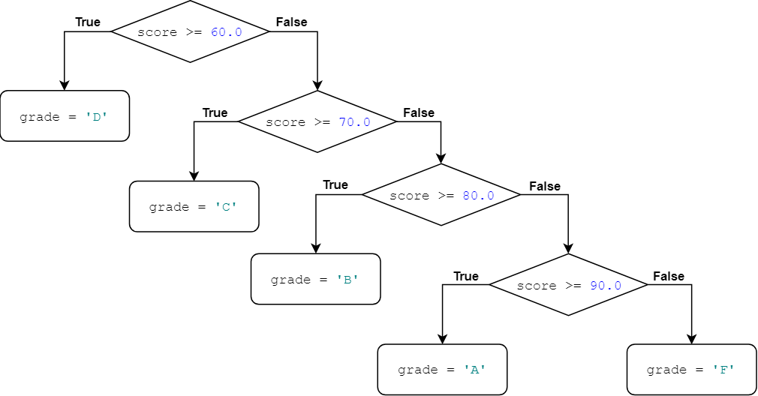
Check Point #10
What is wrong in the following code?
The code has a logic error. It will assign “D” always when score is equal or greater than 60. It will not, for example, assign “A” if the score is equal or greater than 90.
This is because a condition is only tested when all the conditions that come before it are False.
1
2
3
4
5
6
7
8
9
10
if score >= 60.0:
grade = 'D'
elif score >= 70.0:
grade = 'C'
elif score >= 80.0:
grade = 'B'
elif score >= 90.0:
grade = 'A'
else:
grade = 'F'
4.7
Notes:
if score >= 60.0:
grade = 'D'
elif score >= 70.0:
grade = 'C'
elif score >= 80.0:
grade = 'B'
elif score >= 90.0:
grade = 'A'
else:
grade = 'F'

Slide 76
Check Point #10
4.7

Slide 77
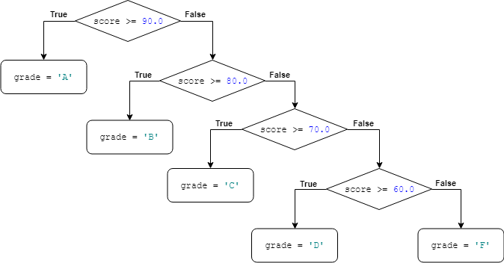
Check Point #10
This is the fix of the previous code:
1
2
3
4
5
6
7
8
9
10
if score >= 90.0:
grade = 'A'
elif score >= 80.0:
grade = 'B'
elif score >= 70.0:
grade = 'C'
elif score >= 60.0:
grade = 'D'
else:
grade = 'F'
4.7
Notes:
if score >= 90.0:
grade = 'A'
elif score >= 80.0:
grade = 'B'
elif score >= 70.0:
grade = 'C'
elif score >= 60.0:
grade = 'D'
else:
grade = 'F'

Slide 78
Check Point #10
4.7

Slide 79
4.8. Common Errors in Selection Statements
Common Errors
Common Pitfalls
Check Point #11 - 13

Slide 80
Common Errors
Most common errors in selection statements are caused by incorrect indentation.
Block 1
Block 2
Block 3
Block 2, Continuation
Block 1, Continuation
4.8

Slide 81
Common Errors Example 1
Consider the following code in (a) and (b):
In (a), the print statement is not in the if block.
To place it in the if block, you have to indent it, as shown in (b).
By the way, (a) has a runtime error: NameError: name 'area' is not defined.
1
2
3
4
5
import math
radius = -20
if radius >= 0:
area = radius * radius * math.pi
print("The area is", area)
1
2
3
4
5
import math
radius = -20
if radius >= 0:
area = radius * radius * math.pi
print("The area is", area)
print("The area is", area)
NameError: name 'area' is not defined
Empty
(a)
(b)
4.8
Notes:
# A
import math
radius = -20
if radius >= 0:
area = radius * radius * math.pi
print("The area is", area)
# B
import math
radius = -20
if radius >= 0:
area = radius * radius * math.pi
print("The area is", area)

Slide 82
Common Errors Example 2
Consider the following code in (a) and (b):
The code in (a) has two if clauses and one else clause. Which if clause is matched by the else clause?
The indentation indicates that the else clause matches the first if clause in (a) and the second if clause in (b).
1
2
3
4
5
6
7
8
i = 1
j = 2
k = 3
if i > j:
if i > k:
print('A')
else:
print('B')
1
2
3
4
5
6
7
8
i = 1
j = 2
k = 3
if i > j:
if i > k:
print('A')
else:
print('B')
B
Empty
(a)
(b)
4.8
Notes:
# A
i = 1
j = 2
k = 3
if i > j:
if i > k:
print('A')
else:
print('B’)
# B
i = 1
j = 2
k = 3
if i > j:
if i > k:
print('A')
else:
print('B')

Slide 83
Common Pitfalls
Common Pitfall 1:
Testing equality of double values.
Common Pitfall 2:
Duplicated statements in if-else or if-elif-else statements.
4.8

Slide 84
Common Pitfalls Pitfall 1
Simplify Boolean variable assignment.
Often, new programmers write code like (a).
This is not an error.
But it is better written (and shorter) as shown in (b).
(b) is equivalent to (a).
1
2
3
4
5
number = eval(input("Enter number: "))
if number % 2 == 0:
even = True
else:
even = False
1
2
number = eval(input("Enter number: "))
even = number % 2 == 0
(a)
(b)
4.8
Notes:
# a
number = eval(input("Enter number: "))
if number % 2 == 0:
even = True
else:
even = False
# b
number = eval(input("Enter number: "))
even = number % 2 == 0

Slide 85
Common Pitfalls Pitfall 2
Avoid duplicating code in different cases.
Often, new programmers write duplicate code that should be combined in one place.
This is not an error.
But the new code (b) removes the duplication and makes the code easy to maintain, because you only need to change in one place if the print statement is modified.
1
2
3
4
5
6
7
8
9
10
total = eval(input("Enter total: "))
if (total >= 100):
discount = 10 / 100
total = total - (discount * total)
print("Final Total: ", total)
else:
discount = 5 / 100
total = total - (discount * total)
print("Final Total: ", total)
1
2
3
4
5
6
7
8
9
10
total = eval(input("Enter total: "))
discount = 0
if (total >= 100):
discount = 10 / 100
else:
discount = 5 / 100
total = total - (discount * total)
print("Final Total: ", total)
(a)
(b)
4.8
Notes:
# a
total = eval(input("Enter total: "))
if (total >= 100):
discount = 10 / 100
total = total - (discount * total)
print("Final Total: ", total)
else:
discount = 5 / 100
total = total - (discount * total)
print("Final Total: ", total)
# b
total = eval(input("Enter total: "))
discount = 0
if (total >= 100):
discount = 10 / 100
else:
discount = 5 / 100
total = total - (discount * total)
print("Final Total: ", total)

Slide 86
Check Point #11
Rewrite the following statement using a Boolean expression:
Solution:
1
2
3
4
if count % 10 == 0:
newLine = True
else:
newLine = False
1
newLine = count % 10 == 0
4.8
Notes:
# Question
if count % 10 == 0:
newLine = True
else:
newLine = False
# Solution
newLine = count % 10 == 0

Slide 87
Check Point #12
Are the following statements correct? Which one is better?
Yes, they are correct.
(b) is better than (a) because it is concise and easy to read.
1
2
3
4
if age < 16:
print("Cannot get a driver's license")
if age >= 16:
print("Can get a driver's license")
(a)
1
2
3
4
if age < 16:
print("Cannot get a driver's license")
else:
print("Can get a driver's license")
(b)
4.8
Notes:
# a
if age < 16:
print("Cannot get a driver's license")
if age >= 16:
print("Can get a driver's license")
# b
if age < 16:
print("Cannot get a driver's license")
else:
print("Can get a driver's license")

Slide 88
Check Point #13
What is the output of the following code if number is 14, 15, and 30?
1
2
3
4
if number % 2 == 0:
print(number, "is even")
if number % 5 == 0:
print(number, "is multiple of 5")
1
2
3
4
if number % 2 == 0:
print(number, "is even")
elif number % 5 == 0:
print(number, "is multiple of 5")
(a)
(b)
14 is even
14 is even
15 is multiple of 5
15 is multiple of 5
30 is even
30 is multiple of 5
30 is even
4.8
Notes:
# a
if number % 2 == 0:
print(number, "is even")
if number % 5 == 0:
print(number, "is multiple of 5")
# b
if number % 2 == 0:
print(number, "is even")
elif number % 5 == 0:
print(number, "is multiple of 5")

Slide 89
4.9. Case Study: Computing Body Mass Index
Program 5: Computing BMI

Slide 90
Computing BMI Program 5
Write a program that computes the Body Mass Index (BMI) for the user. Your program should prompt the user to enter a weight in pounds and height in inches. Your program should then compute and display the BMI and its interpretation for the user.
$$BMI= \frac{Weight (kg)}{{Height (m)}^{2}}$$
$$1 pound= 0.45359237 kilograms$$
$$1 inch=0.0254 meters$$
Enter weight in pounds: 146 <Enter>
Enter height in inches: 70 <Enter>
BMI is 20.95
Normal
4.9

Slide 91
Computing BMI Phase 1: Problem-solving
BMI is a measure of health based on the height and weight.
BMI is calculated by taking the weight (in kilograms) and then dividing it by the square of the height (in meters)
$BMI= \frac{Weight (kg)}{{Height (m)}^{2}}$ = $\frac{Weight (kg)}{Height \left(m\right) × Height (m)}$
The interpretation of BMI for people 20 years or older is as follows:
4.9

Slide 92
Computing BMI Phase 1: Problem-solving
So the user input is in pounds and inches
The BMI equation is in kilograms and meters
Therefore, you will need to convert from:
pounds to kilograms
One pound is 0.45359237 kilograms
$Weight \left(kg\right)=0.45359237×Weight (pound)$
inches to meters
one inch is 0.0254 meters
$Height \left(m\right)=0.0254×Height (inch)$
4.9

Slide 93
Computing BMI Phase 1: Problem-solving
Design your algorithm:
Ask the user to enter the weight and height
Convert weight in pounds to kilograms
$weightInKilograms = weight ∗ 0.45359237$
Convert height in inches to meters
$heightInMeters=height∗ 0.0254$
Compute BMI using BMI equation
$\text{bmi} \text{=} \text{weightInKilograms}\text{ / (}\text{heightInMeters} \text{∗ }\text{heightInMeters}\text{)}$
Print the result (bmi)
Print the interpretation as the following:
“Underweight” if bmi < 18.5
“Normal” if bmi < 25
“Overweight” if bmi < 30
“Obese” if bmi >= 30
4.9

Slide 94
Computing BMI Phase 2: Implementation
LISTING 4.6 ComputeBMI.py
1
2
3
4
5
6
7
8
9
10
11
12
13
14
15
16
17
18
19
20
21
22
23
24
# Prompt the user to enter weight in pounds
weight = eval(input("Enter weight in pounds: "))
# Prompt the user to enter height in inches
height = eval(input("Enter height in inches: "))
KILOGRAMS_PER_POUND = 0.45359237 # Constant
METERS_PER_INCH = 0.0254 # Constant
# Compute BMI
weightInKilograms = weight * KILOGRAMS_PER_POUND
heightInMeters = height * METERS_PER_INCH
bmi = weightInKilograms / (heightInMeters * heightInMeters)
# Display result
print("BMI is", format(bmi, ".2f"))
if bmi < 18.5:
print("Underweight")
elif bmi < 25:
print("Normal")
elif bmi < 30:
print("Overweight")
else:
print("Obese")
Run
4.9
Notes:
# Prompt the user to enter weight in pounds
weight = eval(input("Enter weight in pounds: "))
# Prompt the user to enter height in inches
height = eval(input("Enter height in inches: "))
KILOGRAMS_PER_POUND = 0.45359237 # Constant
METERS_PER_INCH = 0.0254 # Constant
# Compute BMI
weightInKilograms = weight * KILOGRAMS_PER_POUND
heightInMeters = height * METERS_PER_INCH
bmi = weightInKilograms / (heightInMeters * heightInMeters)
# Display result
print("BMI is", format(bmi, ".2f"))
if bmi < 18.5:
print("Underweight")
elif bmi < 25:
print("Normal")
elif bmi < 30:
print("Overweight")
else:
print("Obese")

Slide 95
Computing BMI Example Runs of The Program
Enter weight in pounds: 146 <Enter>
Enter height in inches: 70 <Enter>
BMI is 20.95
Normal
Enter weight in pounds: 176 <Enter>
Enter height in inches: 66 <Enter>
BMI is 28.41
Overweight
4.9

Slide 96
Computing BMI Trace The Program Execution
Enter weight in pounds: 146 <Enter>
Enter height in inches: 70 <Enter>
BMI is 20.95
Normal
20
4.9

Slide 97
Computing BMI Discussion
The two named constants, KILOGRAMS_PER_POUND and METERS_PER_INCH, are defined in lines 7-8.
Named constants were introduced in Chapter 2.
Using named constants here makes programs easy to read.
Unfortunately, there is no special syntax for defining named constants in Python.
Named constants are treated just like variables in Python.
This book uses the format of writing constants in all uppercase letters to distinguish them from variables and separates the words in constants with an underscore (_).
4.9

Slide 98
4.11. Logical Operators
Truth Table for Operator not
Truth Table for Operator and
Truth Table for Operator or
Program 6: Test Boolean Operators
De Morgan’s law
Notes
Check Point #14 - #21

Slide 99
Logical Operators
We have used conditional statements to help us determine if the execution should take one path (true path) or another path (false path).
But until now, these conditional statements have been very basic.
Usually, whether a statement is executed is determined by a combination of several conditions.
You can use logical operators to combine these conditions to form a compound Boolean expression.
4.11

Slide 100
Logical Operators
Logical operators, also known as Boolean operators, operate on Boolean values to create a new Boolean value.
The following slide shows the three logical operators we will use.
The following slides show a truth table for each logical operator and some examples.
4.11

Slide 101
Logical Operators
4.11

Slide 102
Truth Table for Operator not
4.11

Slide 103
Truth Table for Operator not Examples
>>> not True
False
>>> not ( 20 > 60 )
True
>>> not 60 > 20
False
>>> not ( not ( True ) )
True
>>> not not False
False
4.11
Notes:
not True
not ( 20 > 60 )
not 60 > 20
not ( not ( True ) )
not not False

Slide 104
Truth Table for Operator and
4.11

Slide 105
Truth Table for Operator and Examples
>>> True and False and True and True
False
>>> True and not False
True
>>> not not True and 10 > 20
False
>>> not False and not False and not not not False
True
>>> not (True and False) and True
True
>>> not True and False and True
False
4.11
Notes:
True and False and True and True
True and not False
not not True and 10 > 20
not False and not False and not not not False
not (True and False) and True
not True and False and True

Slide 106
Truth Table for Operator or
or
4.11

Slide 107
Truth Table for Operator or Examples
>>> True or False
True
>>> True or False and False and False and True
True
>>> False or not True
False
>>> not (True and False) or 20 > 10
True
>>> not True and False or True
True
>>> not True and (False or True)
False
4.11
Notes:
True or False
True or False and False and False and True
False or not True
not (True and False) or 20 > 10
not True and False or True
not True and (False or True)

Slide 108
Test Boolean Operators Program 6
Write a program that tests the usage of Boolean operators. Specifically, your program should prompt the user to enter one integer. Your program should then determine if the value is divisible by 2 and 3, by 2 or 3, or by 2 or 3 but not both.
Enter an integer: 18 <Enter>
18 is divisible by 2 and 3
18 is divisible by 2 or 3
Enter an integer: 15 <Enter>
15 is divisible by 2 or 3
15 is divisible by 2 or 3, but not both
4.11

Slide 109
Test Boolean Operators Phase 1: Problem-solving
Note:
So how do we check for divisibility?
We use mod (%).
Example: check if some number, x, is divisible by 3
if x % 3 == 0
This says: if we divide x by 3 and the remainder is zero …
And that is exactly what we want!
However, we must check the divisibility of two numbers
both 2 and 3
This means we must use logical operators
if x % 2 == 0 and x % 3 == 0
4.11

Slide 110
Test Boolean Operators Phase 1: Problem-solving
Design your algorithm:
Ask the user to enter the number
If (number % 2 == 0) and (number % 3 == 0)
Print: number is divisible by 2 and 3
If (number % 2 == 0) or (number % 3 == 0)
Print: number is divisible by 2 or 3
If ( (number % 2 == 0) or (number % 3 == 0) ) and (not ( (number % 2 == 0) and (number % 3 == 0) ) )
Print: number is divisible by 2 or 3, but not both
4.11

Slide 111
Test Boolean Operators Phase 2: Implementation
LISTING 4.8 TestBooleanOperators.py
1
2
3
4
5
6
7
8
9
10
11
12
13
# Receive an input
number = eval(input("Enter an integer: "))
if number % 2 == 0 and number % 3 == 0:
print(number, "is divisible by 2 and 3")
if number % 2 == 0 or number % 3 == 0:
print(number, "is divisible by 2 or 3")
if (number % 2 == 0 or number % 3 == 0) and \
not (number % 2 == 0 and number % 3 == 0):
print(number, "is divisible by 2 or 3, but not both")
Run
Enter an integer: 18 <Enter>
18 is divisible by 2 and 3
18 is divisible by 2 or 3
Enter an integer: 15 <Enter>
15 is divisible by 2 or 3
15 is divisible by 2 or 3, but not both
4.11
Notes:
# Receive an input
number = eval(input("Enter an integer: "))
if number % 2 == 0 and number % 3 == 0:
print(number, "is divisible by 2 and 3")
if number % 2 == 0 or number % 3 == 0:
print(number, "is divisible by 2 or 3")
if (number % 2 == 0 or number % 3 == 0) and \
not (number % 2 == 0 and number % 3 == 0):
print(number, "is divisible by 2 or 3, but not both")

Slide 112
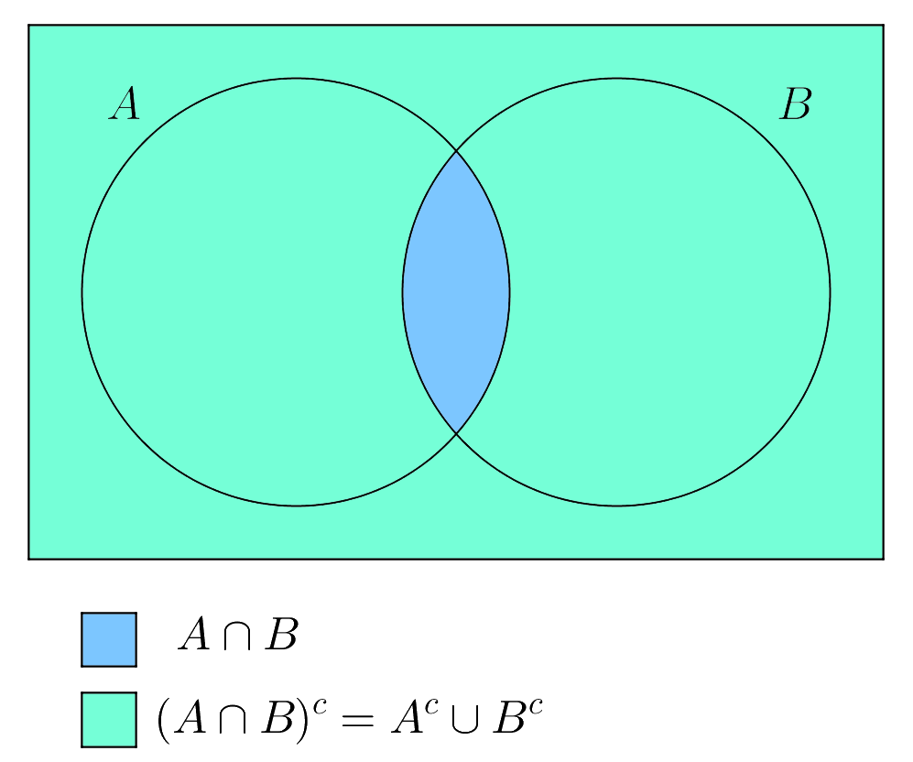
De Morgan’s law (1)
not (condition1 and condition2)
is the same as
not condition1 or not condition2
Example, the following Boolean expression:
is better written as:
not (number % 2 == 0 and number % 3 == 0)
number % 2 != 0 or number % 3 != 0
4.11
Notes:
not (number % 2 == 0 and number % 3 == 0)
number % 2 != 0 or number % 3 != 0

Slide 113
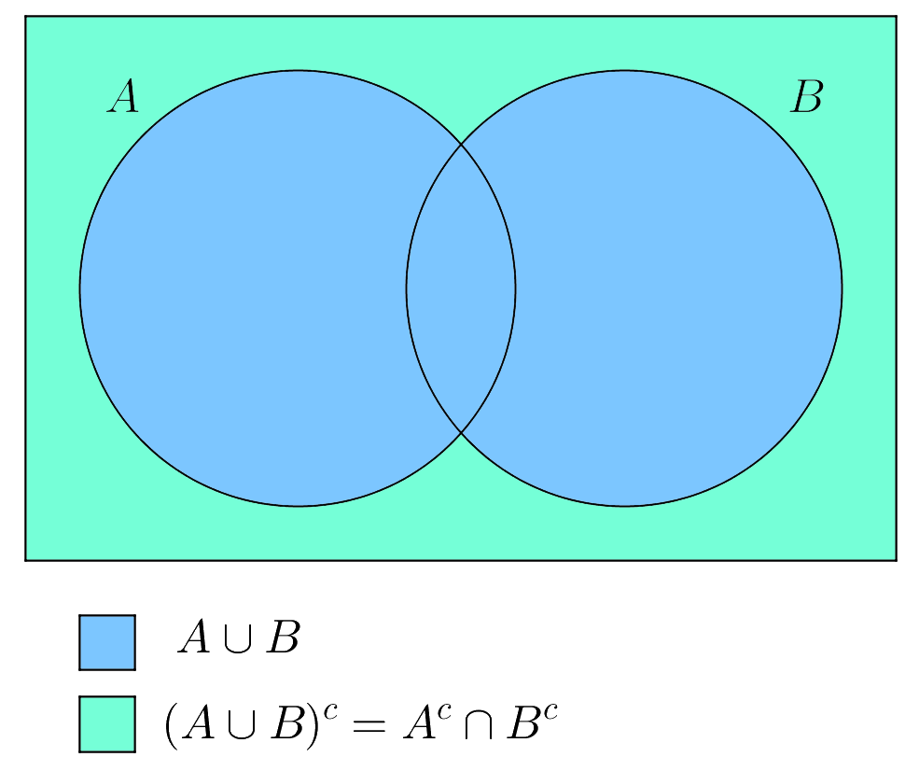
De Morgan’s law (2)
not (condition1 or condition2)
is the same as
not condition1 and not condition2
Example, the following Boolean expression:
is better written as:
not (number == 2 or number == 3)
number != 2 and number != 3
4.11
Notes:
not (number == 2 or number == 3)
number != 2 and number != 3

Slide 114
Notes
If one of the operands of an and operator is False, the expression is False.
Example: when evaluating p1 and p2
Python first evaluates p1
if p1 is True, evaluates p2
if p1 is False, it does not evaluate p2
if one of the operands of an or operator is True, the expression is True.
Example: when evaluating p1 or p2
Python first evaluates p1
if p1 is False, evaluates p2
if p1 is True, it does not evaluate p2
Python uses these properties to improve the performance of these operators.
4.11

Slide 115
Notes
The following Boolean expression:
can be simplified by using an equivalent expression:
The following Boolean expression:
can be simplified by using an equivalent expression:
number >= x and number < y
x <= number < y
number != x and number == y
x != number == y
4.11
Notes:
number >= x and number < y
x <= number < y
number != x and number == y
x != number == y

Slide 116
Check Point #14
Assuming that x is 1, show the result of the following Boolean expressions:
True and (3 > 4)
False
not (x > 0) and (x > 0)
False
(x > 0) or (x < 0)
True
(x != 0) or (x == 0)
True
(x >= 0) or (x < 0)
True
(x != 1) == (not (x == 1))
True
4.11
Notes:
True and (3 > 4)
not (x > 0) and (x > 0)
(x > 0) or (x < 0)
(x != 0) or (x == 0)
(x >= 0) or (x < 0)
(x != 1) == (not (x == 1))

Slide 117
Check Point #15
Write a Boolean expression that evaluates to True if variable num is between 1 and 100.
Solution:
Or (equivalent):
1 <= num <= 100
num >= 1 and num <= 100
4.11
Notes:
1 <= num <= 100
num >= 1 and num <= 100

Slide 118
Check Point #16
Write a Boolean expression that evaluates to True if variable num is between 1 and 100 or num is negative.
Solution:
Or (equivalent):
(1 <= num <= 100) or (num < 0)
(num >= 1 and num <= 100) or (num < 0)
4.11
Notes:
(1 <= num <= 100) or (num < 0)
(num >= 1 and num <= 100) or (num < 0)

Slide 119
Check Point #17
Assuming x = 4 and y = 5, show the result of the following Boolean expressions:
x >= y >= 0
False
x <= y >= 0
True
x != y == 5
True
(x != 0) or (x == 0)
True
4.11
Notes:
x >= y >= 0
x <= y >= 0
x != y == 5
(x != 0) or (x == 0)

Slide 120
Check Point #18
Write a Boolean expression that evaluates to True if age is greater than 13 and less than 18.
Solution:
Or (equivalent):
13 < age < 18
age > 13 and age < 18
4.11
Notes:
13 < age < 18
age > 13 and age < 18

Slide 121
Check Point #19
Write a Boolean expression that evaluates to True if weight is greater than 50 or height is greater than 160.
Solution:
weight > 50 or height > 160
4.11
Notes:
weight > 50 or height > 160

Slide 122
Check Point #20
Write a Boolean expression that evaluates to True if weight is greater than 50 and height is greater than 160.
Solution:
weight > 50 and height > 160
4.11
Notes:
weight > 50 and height > 160

Slide 123
Check Point #21
Write a Boolean expression that evaluates to True if either weight is greater than 50 or height is greater than 160, but not both.
Solution:
(weight > 50 or height > 160) and not (weight > 50 and height > 160)
4.11
Notes:
(weight > 50 or height > 160) and not (weight > 50 and height > 160)

Slide 124
4.12. Case Study: Determining Leap Years
Program 7: Leap Year

Slide 125
Leap Year Program 7
Write a program that determines if a given year is a leap year. Specifically, ask the user to enter a year. Then determine if that year is a leap year and display the results.
Note: A year is a leap year if it is divisible by 4 but not by 100 or if it is divisible by 400.
Enter a year: 2008 <Enter>
2008 is a leap year? True
Enter a year: 1900 <Enter>
1900 is a leap year? False
Enter a year: 2002 <Enter>
2002 is a leap year? False
4.12

Slide 126
Leap Year Phase 1: Problem-solving
What is a leap year?
A leap year has 366 days (instead of 365)
Why?
The earth takes approximately 365.25 days to circle around the sun
However, the Gregorian year has only 365 days
Therefore, every four years, the number of days is increased to 366
A year is a leap year if it is divisible by 4 but not by 100 or if it is divisible by 400.
4.12

Slide 127
Leap Year Phase 1: Problem-solving
Which years are leap years?
There are three criteria:
A leap year is divisible by 4
A leap year is divisible by 4 but not by 100
A leap year is divisible by 4 but not by 100 or divisible by 400
isLeapYear = (year % 4 == 0)
isLeapYear = isLeapYear and (year % 100 != 0)
isLeapYear = isLeapYear or (year % 400 == 0)
4.12
Notes:
isLeapYear = (year % 4 == 0)
isLeapYear = isLeapYear and (year % 100 != 0)
isLeapYear = isLeapYear or (year % 400 == 0)

Slide 128
Leap Year Phase 1: Problem-solving
So, you can use the following Boolean expressions to determine whether a year is a leap year:
or you can combine all these expressions into one, like this:
# A leap year is divisible by 4
isLeapYear = (year % 4 == 0)
# A leap year is divisible by 4 but not by 100
isLeapYear = isLeapYear and (year % 100 != 0)
# A leap year is divisible by 4 but not by 100 or divisible by 400
isLeapYear = isLeapYear or (year % 400 == 0)
isLeapYear = (year % 4 == 0 and year % 100 != 0) or (year % 400 == 0)
4.12
Notes:
# A leap year is divisible by 4
isLeapYear = (year % 4 == 0)
# A leap year is divisible by 4 but not by 100
isLeapYear = isLeapYear and (year % 100 != 0)
# A leap year is divisible by 4 but not by 100 or divisible by 400
isLeapYear = isLeapYear or (year % 400 == 0)
isLeapYear = (year % 4 == 0 and year % 100 != 0) or (year % 400 == 0)

Slide 129
Leap Year Phase 1: Problem-solving
Design your algorithm:
Ask the user to enter the year
If (year % 4 == 0 and year % 100 != 0) or (year % 400 == 0)
Print: year is a leap year? True
Otherwise
Print: year is a leap year? False
4.12

Slide 130
Leap Year Phase 2: Implementation
LISTING 4.9 LeapYear.py
1
2
3
4
5
6
7
8
9
year = eval(input("Enter a year: "))
# Check if the year is a leap year
isLeapYear = (year % 4 == 0 and year % 100 != 0) or \
(year % 400 == 0)
# Display the result
print(year, "is a leap year?", isLeapYear)
Run
Enter a year: 2008 <Enter>
2008 is a leap year? True
Enter a year: 1900 <Enter>
1900 is a leap year? False
Enter a year: 2002 <Enter>
2002 is a leap year? False
4.12
Notes:
year = eval(input("Enter a year: "))
# Check if the year is a leap year
isLeapYear = (year % 4 == 0 and year % 100 != 0) or \
(year % 400 == 0)
# Display the result
print(year, "is a leap year?", isLeapYear)

Slide 131
4.13. Case Study: Lottery
Program 8: Lottery

Slide 132
Lottery Program 8
Write a program to play a lottery. The program randomly generates a two-digit number, prompts the user to enter a two-digit number, and determines whether the user wins according to the following rules:
If the user’s input matches the lottery in the exact order, the award is $10,000.
If all the digits in the user’s input match all the digits in the lottery number, the award is $3,000.
If one digit in the user’s input matches a digit in the lottery number, the award is $1,000.
Enter your lottery pick (two digits): 45 <Enter>
The lottery number is 12
Sorry, no match
Enter your lottery pick (two digits): 23 <Enter>
The lottery number is 34
Match one digit: you win $1,000
4.13

Slide 133
Lottery Phase 1: Problem-solving
So how do we compare digits?
Give a two-digit number, how can isolate the individual digits in order to compare them?
Example: given the number 73, how can we extract the 7 and the 3? How can we “get” them as individual numbers?
Solution: integer division (//) and mod (%)
Example: 73
73 // 10 = 7
73 % 10 = 3
This is exactly what we want!
Note:
you will use mod (%) a lot in this course!
4.13

Slide 134
Lottery Phase 1: Problem-solving
Design your algorithm:
Randomly generate a lottery number between 10 and 99.
lottery = random.randint(10, 99)
Ask the user to enter the two-digit number (guess)
Get digits from lottery
lotteryDigit1 = lottery // 10
lotteryDigit2 = lottery % 10
Get digits from guess
guessDigit1 = guess // 10
guessDigit2 = guess % 10
4.13

Slide 135
Lottery Phase 1: Problem-solving
Design your algorithm:
Compare user number (guess) with winning number (lottery) and determine winning amount (if any).
First check whether the guess matches the lottery number exactly.
if guess == lottery
If not, check whether the reversal of the guess matches the lottery number.
elif (guessDigit2 == lotteryDigit1 and guessDigit1 == lotteryDigit2)
If not, check whether one digit is in the lottery number.
elif (guessDigit1 == lotteryDigit1 or guessDigit1 == lotteryDigit2 or guessDigit2 == lotteryDigit1 or guessDigit2 == lotteryDigit2)
If not, nothing matches and display Sorry, no match.
else
Display results to user
4.13

Slide 136
Lottery Phase 2: Implementation
LISTING 4.10 Lottery.py
1
2
3
4
5
6
7
8
9
10
11
12
13
14
15
16
17
import random
# Generate a lottery
lottery = random.randint(10, 99)
# Prompt the user to enter a guess
guess = eval(input("Enter your lottery pick (two digits): "))
# Get digits from lottery
lotteryDigit1 = lottery // 10
lotteryDigit2 = lottery % 10
# Get digits from guess
guessDigit1 = guess // 10
guessDigit2 = guess % 10
print("The lottery number is", lottery)
Run
4.13
Notes:
import random
# Generate a lottery
lottery = random.randint(10, 99)
# Prompt the user to enter a guess
guess = eval(input("Enter your lottery pick (two digits): "))
# Get digits from lottery
lotteryDigit1 = lottery // 10
lotteryDigit2 = lottery % 10
# Get digits from guess
guessDigit1 = guess // 10
guessDigit2 = guess % 10
print("The lottery number is", lottery)
# Check the guess
if guess == lottery:
print("Exact match: you win $10,000")
elif (guessDigit2 == lotteryDigit1 and \
guessDigit1 == lotteryDigit2):
print("Match all digits: you win $3,000")
elif (guessDigit1 == lotteryDigit1
or guessDigit1 == lotteryDigit2
or guessDigit2 == lotteryDigit1
or guessDigit2 == lotteryDigit2):
print("Match one digit: you win $1,000")
else:
print("Sorry, no match")

Slide 137
Lottery Phase 2: Implementation
LISTING 4.10 Lottery.py
18
19
20
21
22
23
24
25
26
27
28
29
30
31
# Check the guess
if guess == lottery:
print("Exact match: you win $10,000")
elif (guessDigit2 == lotteryDigit1 and \
guessDigit1 == lotteryDigit2):
print("Match all digits: you win $3,000")
elif (guessDigit1 == lotteryDigit1
or guessDigit1 == lotteryDigit2
or guessDigit2 == lotteryDigit1
or guessDigit2 == lotteryDigit2):
print("Match one digit: you win $1,000")
else:
print("Sorry, no match")
Run
Enter your lottery pick (two digits): 45 <Enter>
The lottery number is 12
Sorry, no match
Enter your lottery pick (two digits): 23 <Enter>
The lottery number is 34
Match one digit: you win $1,000
4.13
Notes:
import random
# Generate a lottery
lottery = random.randint(10, 99)
# Prompt the user to enter a guess
guess = eval(input("Enter your lottery pick (two digits): "))
# Get digits from lottery
lotteryDigit1 = lottery // 10
lotteryDigit2 = lottery % 10
# Get digits from guess
guessDigit1 = guess // 10
guessDigit2 = guess % 10
print("The lottery number is", lottery)
# Check the guess
if guess == lottery:
print("Exact match: you win $10,000")
elif (guessDigit2 == lotteryDigit1 and \
guessDigit1 == lotteryDigit2):
print("Match all digits: you win $3,000")
elif (guessDigit1 == lotteryDigit1
or guessDigit1 == lotteryDigit2
or guessDigit2 == lotteryDigit1
or guessDigit2 == lotteryDigit2):
print("Match one digit: you win $1,000")
else:
print("Sorry, no match")

Slide 138
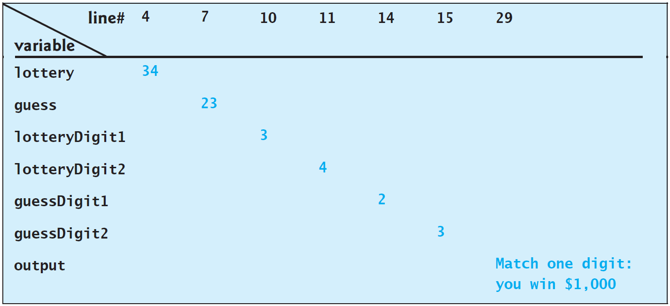
Lottery Trace The Program Execution
Enter your lottery pick (two digits): 23 <Enter>
The lottery number is 34
Match one digit: you win $1,000
4.13

Slide 139
4.14. Conditional Expressions
Check Point #22 - #27

Slide 140
Conditional Expressions
You might want to assign a value to a variable that is restricted by certain conditions.
For example, the following statement assigns 1 to y if x is greater than 0, and -1 to y if x is less than or equal to 0.
Alternatively, you can use a conditional expression to achieve the same result.
if x > 0:
y = 1
else:
y = -1
y = 1 if x > 0 else -1
4.14
Notes:
if x > 0:
y = 1
else:
y = -1
y = 1 if x > 0 else -1

Slide 141
Conditional Expressions
A conditional expression evaluates an expression based on a condition.
Conditional expressions are in a completely different style. The syntax is:
The result of this conditional expression is expression1 if boolean-expression is True; otherwise, the result is expression2.
expression1 if boolean-expression else expression2
4.14

Slide 142
Conditional Expressions Example 1
Given two numbers, number1 and number2, save the larger into a variable called max.
You can do this with an if/else statement
Or you can use one conditional expression as follows:
if number1 > number2:
max = number1
else:
max = number2
max = number1 if number1 > number2 else number2
4.14
Notes:
#
if number1 > number2:
max = number1
else:
max = number2
#
max = number1 if number1 > number2 else number2

Slide 143
Conditional Expressions Example 2
Given a variable, number, display the message “number is even” if number is even; otherwise, display “number is odd”.
You can do this with an if/else statement
Or you can use one conditional expression as follows:
if number % 2 == 0:
print(number, "is even")
else:
print(number, "is odd")
print(number, "is even" if number % 2 == 0 else "is odd")
4.14
Notes:
#
if number % 2 == 0:
print(number, "is even")
else:
print(number, "is odd")
#
print(number, "is even" if number % 2 == 0 else "is odd")

Slide 144
Check Point #22
Suppose that when you run the following program, you enter the input 2, 3, 6 from the console. What is the output?
The output is: sorted
It is equivalent to:
1
2
x, y, z = eval(input("Enter three numbers: "))
print("sorted" if x < y and y < z else "not sorted")
1
2
3
4
5
x, y, z = eval(input("Enter three numbers: "))
if x < y and y < z:
print("sorted")
else:
print("not sorted")
4.14
Notes:
# Q
x, y, z = eval(input("Enter three numbers: "))
print("sorted" if x < y and y < z else "not sorted")
# S
x, y, z = eval(input("Enter three numbers: "))
if x < y and y < z:
print("sorted")
else:
print("not sorted")

Slide 145
Check Point #23
Rewrite the following if statement using a conditional expression:
Solution:
if ages >= 16:
ticketPrice = 20
else:
ticketPrice = 10
ticketPrice = 20 if ages >= 16 else 10
4.14
Notes:
# Q
if ages >= 16:
ticketPrice = 20
else:
ticketPrice = 10
# S
ticketPrice = 20 if ages >= 16 else 10

Slide 146
Check Point #24
Rewrite the following if statement using a conditional expression:
Solution:
if count % 10 == 0:
print(count)
else:
print(count, end = " ")
print(count, end = "\n" if count % 10 == 0 else " ")
4.14
Notes:
# Q
if count % 10 == 0:
print(count)
else:
print(count, end = " ")
# S
print(count, end = " " if count % 10 == 0 else "\n")

Slide 147
Check Point #25
Rewrite the following conditional expressions using if/else statements:
Solution:
score = 3 * scale if x > 10 else 4 * scale
if x > 10:
score = 3 * scale
else:
score = 4 * scale
4.14
Notes:
# Q
score = 3 * scale if x > 10 else 4 * scale
# S
if x > 10:
score = 3 * scale
else:
score = 4 * scale

Slide 148
Check Point #26
Rewrite the following conditional expressions using if/else statements:
Solution:
tax = income * 0.2 if income > 10000 else income * 0.17 + 1000
if income > 10000:
tax = income * 0.2
else:
tax = income * 0.17 + 1000
4.14
Notes:
# Q
tax = income * 0.2 if income > 10000 else income * 0.17 + 1000
# S
if income > 10000:
tax = income * 0.2
else:
tax = income * 0.17 + 1000

Slide 149
Check Point #27
Rewrite the following conditional expressions using if/else statements:
Solution:
print(i if number % 3 == 0 else j)
if number % 3 == 0:
print(i)
else:
print(j)
4.14
Notes:
# Q
print(i if number % 3 == 0 else j)
# S
if number % 3 == 0:
print(i)
else:
print(j)

Slide 150
4.15. Operator Precedence and Associativity
Operator Precedence
Associativity
Check Point #28 - #29

Slide 151
Operator Precedence
Chapter 2 introduced operator precedence involving arithmetic operators.
Example:
* and / has higher precedence than + and –
But what about expressions with other operators
Example:
3 + 4 * 4 > 5 * (4 + 3) – 1
What is the value? What is the execution order of the above example?
We need to know the precedence rules for this!
4.15

Slide 152
Operator Precedence
Operator precedence and operator associativity determine the order in which Python evaluates operators.
The expression in the parentheses is evaluated first.
Parentheses can be nested, in which case the expression in the inner parentheses is executed first.
When evaluating an expression without parentheses, the operators are applied according to the precedence rule and the associativity rule.
The precedence rule defines precedence for operators.
In the next slide, Table 4.7 contains the operators you have learned so far, with the operators listed in decreasing order of precedence from top to bottom.
4.15

Slide 153
Operator Precedence
(Corrected)
4.15

Slide 154
Associativity
If operators with the same precedence are next to each other, their associativity determines the order of evaluation.
All binary operators except assignment operators are left-associative.
Example:
a – b + c – d is equivalent to ((a – b) + c) – d
Assignment operators are right-associative.
Example:
a = b += c = 5 is equivalent to a = (b += (c = 5))
4.15

Slide 155
Check Point #28
List the precedence order of the Boolean operators.
Solution:
The decreasing order of precedence order of the Boolean operators:
not
and
or
4.15

Slide 156
Check Point #29
Evaluate the following expressions:
True or True and False
True
True and True or False
True
( True and not True ) or False or 10 < 3
False
not ( 20 > 40 and not 40 > 20 ) and True
True
4.15
Notes:
True or True and False
True and True or False
( True and not True ) or False or 10 < 3
not ( 20 > 40 and not 40 > 20 ) and True

Slide 157
Debugging

Slide 158
Debugging
Dealing with programming errors:
Remember: syntax errors and runtime errors are not difficult to find.
However, logic errors can be very challenging.
Logic errors are called bugs.
Debugging is the process of finding and corrected these logic errors.
Debugging

Slide 159
Debugging
Methods of debugging:
1- You can hand-trace the program.
Meaning, you try to find the error by reading the program
Clearly, this is very difficult and time consuming.
2- You can insert print statements throughout the program.
The print statements allow you to see how far the execution has reached.
You can also print, and then view, the values of variables during execution of the program.
Again, this is time consuming.
Debugging

Slide 160
Debugging
Methods of debugging:
These two methods are okay, but they are slow.
They really only work for small, simple programs.
So what about large, complex programs?
The best solution is to use a debugger utility. (Method 3)
Most of Python IDE programs, such as PyCharm and IDLE, include integrated debuggers.
Learning how to use these debuggers is very important.
Debugging

Slide 161
Debugging
Debugger is a program that facilitates debugging.
You can use a debugger to
Execute a single statement at a time.
Trace into or stepping over a method.
Set breakpoints.
Display variables.
Display call stack.
Modify variables.
Debugging

Slide 162
Debugging By Using PyCharm
Debugging

Slide 163
End
Test Questions
Programming Exercises

Slide 164
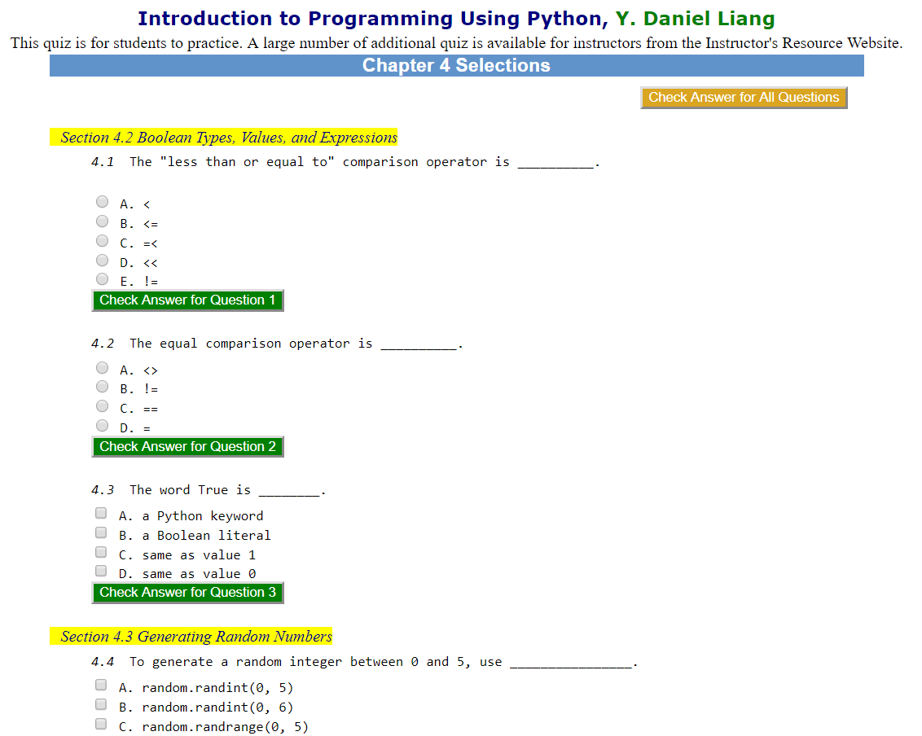
Test Questions
Do the test questions for this chapter online at https://liveexample-ppe.pearsoncmg.com/selftest/selftestpy?chapter=4

Slide 165
Programming Exercises
Page 120 – 132:
4.1 - 4.15
4.17 - 4.21
4.24
4.30
Lab #6

