Slide 1
Chapter 3 Mathematical Functions, and Strings
CPIT 110 (Problem-Solving and Programming)
Introduction to Programming Using Python, By: Y. Daniel Liang
Notes:
By: Ahmad Tayeb (@ahmad_tayeb)
https://ajtayeb.kau.edu.sa
Last Update: 29/8/2020
Version 2.5
Textbook:
Introduction to Programming Using Python, By: Y. Daniel Liang

Slide 2
Sections
3.1. Motivations
3.2. Common Python Functions
3.3. Strings and Characters
3.4. Case Study: Minimum Number of Coins
3.6. Formatting Numbers and Strings
Programs Check Points Labs

Slide 3
Programs
Python Online IDE
Program 1: Compute Angles
Program 2: Compute Change
Problem 3: Print a Table

Slide 4
Check Points
Section 3.2
#1
Section 3.3
#2
#3
Section 3.6
#4
#5

Slide 5
Objectives
To solve mathematics problems by using the functions in the math module (3.2).
To represent and process strings and characters (3.3-3.4).
To represent special characters using the escape sequence (3.3.4).
To invoke the print function with the end argument (3.3.5).
To convert numbers to a string using the str function (3.3.6).
To use the + operator to concatenate strings (3.3.7).
To read strings from the console (3.3.8).
To format numbers and strings using the format function (3.6).

Slide 6
3.1. Motivations

Slide 7
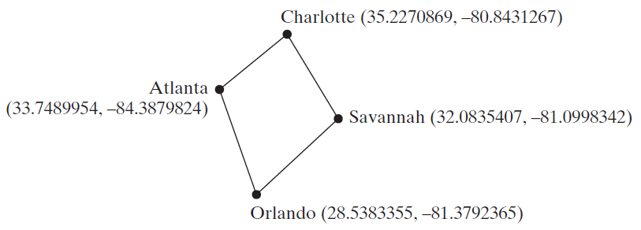
Motivations
Suppose you need to estimate the area enclosed by four cities, given the GPS locations (latitude and longitude) of these cities, as shown in the following diagram. How would you write a program to solve this problem? You will be able to write such a program after completing this chapter.
3.1

Slide 8
3.2. Common Python Functions
Python Built-in Functions
Simple Python Built-in Functions
math Module
Problem 1: Compute Angles
Check Point #1

Slide 9
Python Built-in Functions
A function is a group of statements that performs a specific task.
Python, as well as other programming languages, provides a library of functions.
You have already used the functions eval, input, print, and int.
These are built-in functions and they are always available in the Python interpreter. You don’t have to import any modules to use these functions.
Additionally, you can use the built-in functions abs, max, min, pow, and round, as shown in the following slide.
3.2

Slide 10
Simple Python Built-in Functions
3.2

Slide 11
Simple Python Built-in Functions Example
>>> abs(-3) # Returns the absolute value
3
>>> abs(-3.5) # Returns the absolute value
3.5
>>> max(2, 3, 4, 6) # Returns the maximum number
6
>>> min(2, 3, 4) # Returns the minimum number
2
>>> pow(2, 3) # Same as 2 ** 3
8
>>> pow(2.5, 3.5) # Same as 2.5 ** 3.5
24.705294220065465
>>> round(3.51) # Rounds to its nearest integer
4
>>> round(3.4) # Rounds to its nearest integer
3
>>> round(3.1456, 3) # Rounds to 3 digits after the decimal point
3.146
3.2
Notes:
abs(-3) # Returns the absolute value
abs(-3.5) # Returns the absolute value
max(2, 3, 4, 6) # Returns the maximum number
min(2, 3, 4) # Returns the minimum number
pow(2, 3) # Same as 2 ** 3
pow(2.5, 3.5) # Same as 2.5 ** 3.5
round(3.51) # Rounds to its nearest integer
round(3.4) # Rounds to its nearest integer
round(3.1456, 3) # Rounds to 3 digits after the decimal point

Slide 12
math Module
Many programs are created to solve mathematical problems.
Some of the most popular mathematical functions are defined in the Python math module. These include trigonometric functions, representation functions, logarithmic functions, angle conversion functions, etc.
In addition, two mathematical constants (pi and e) are also defined in this module.
3.2

Slide 13
math Module
The Python math module provides the mathematical functions listed in the following slide.
To use functions in a module, you have to import it first as the following syntax:
For example, we have to import the math module before using its functions or constants :
import module_name
>>> import math
>>> math.pi # pi is a constant
3.141592653589793
>>> math.cos(5.89) # cos is a function
0.92369335287311
3.2
Notes:
import math
math.pi # pi is a constant
math.cos(5.89) # cos is a function

Slide 14
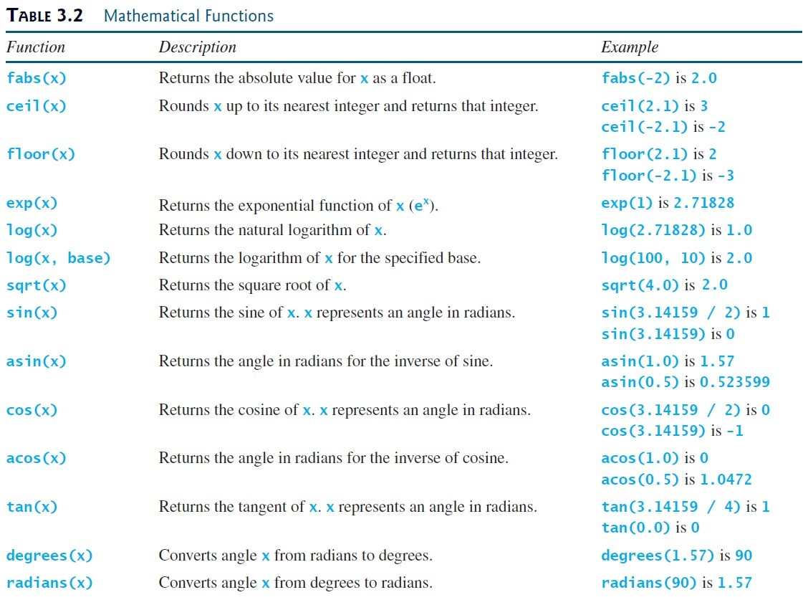
3.2

Slide 15
math Module Example
LISTING 3.1 MathFunctions.py
1
2
3
4
5
6
7
8
9
10
11
12
13
14
import math # import Math module to use the math functions
# Test algebraic functions
print("exp(1.0) =", math.exp(1))
print("log(math.e) =", math.log(math.e))
print("log10(10, 10) =", math.log(10, 10))
print("sqrt(4.0) =", math.sqrt(4.0))
# Test trigonometric functions
print("sin(PI / 2) =", math.sin(math.pi / 2))
print("cos(PI / 2) =", math.cos(math.pi / 2))
print("tan(PI / 2) =", math.tan(math.pi / 2))
print("degrees(1.57) =", math.degrees(1.57))
print("radians(90) =", math.radians(90))
3.2
Notes:
import math # import Math module to use the math functions
# Test algebraic functions
print("exp(1.0) =", math.exp(1))
print("log(3.78) =", math.log(math.e))
print("log10(10, 10) =", math.log(10, 10))
print("sqrt(4.0) =", math.sqrt(4.0))
# Test trigonometric functions
print("sin(PI / 2) =", math.sin(math.pi / 2))
print("cos(PI / 2) =", math.cos(math.pi / 2))
print("tan(PI / 2) =", math.tan(math.pi / 2))
print("degrees(1.57) =", math.degrees(1.57))
print("radians(90) =", math.radians(90))

Slide 16
math Module The Output of The Example
exp(1.0) = 2.718281828459045
log(math.e) = 1.0
log10(10, 10) = 1.0
sqrt(4.0) = 2.0
sin(PI / 2) = 1.0
cos(PI / 2) = 6.123233995736766e-17
tan(PI / 2) = 1.633123935319537e+16
degrees(1.57) = 89.95437383553924
radians(90) = 1.5707963267948966
3.2

Slide 17
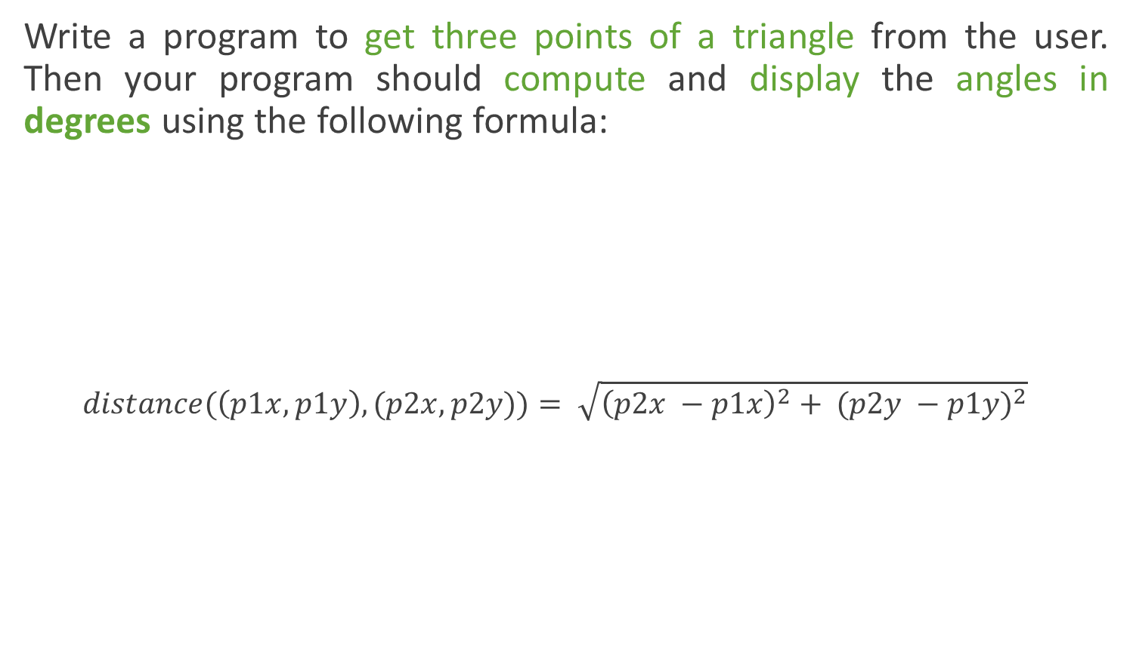
Compute Angles Program 1
Write a program to get three points of a triangle from the user. Then your program should compute and display the angles in degrees using the following formula:
$$distance(\left(p1x,p1y\right), (p2x,p2y))= \sqrt{{\left(p2x −p1x\right)}^{2}+ {(p2y −p1y)}^{2}}$$
Note: acos(x) returns the arc cosine of x, in radians
Enter three points: 1, 1, 6.5, 1, 6.5, 2.5 <Enter>
The three angles are 15.26 90.0 74.74
3.2

Slide 18
Remember
Don’t be intimidated by the mathematical formula.
As we discussed early in Chapter 2, Program 9 (Computing Loan Payments), You don’t have to know how the mathematical formula is derived in order to write a program for computing the loan payments.
Here in this example (Program 1):
Given the length of three sides, you can use the given formula to write a program to compute the angles without having to know how the formula is derived.
In order to compute the lengths of the sides, we need to know the coordinates of three corner points and compute the distances between the points.
3.2

Slide 19
Compute Angles Phase 1: Problem-solving
The problem didn't give us specific formulas to calculate a, b, and c. But it gives us a general formula to calculate the distance of two points (p1, p2).
So, we can use this formula to generate formulas for calculating a, b, and c as the following:
$$distance(\left(p1x,p1y\right), (p2x,p2y))= \sqrt{{\left(p2x −p1x\right)}^{2}+ {(p2y −p1y)}^{2}}$$
$$a= \sqrt{{\left(x2 −x3\right)}^{2}+ {(y2 −y3)}^{2}}$$
$$b= \sqrt{{\left(x1 −x3\right)}^{2}+ {(y1 −y3)}^{2}}$$
$$c= \sqrt{{\left(x1 −x2\right)}^{2}+ {(y1 −y2)}^{2}}$$
3.2

Slide 20
Compute Angles Phase 1: Problem-solving
Design your algorithm:
Get three points.
Use input function
1 point = x and y (two inputs)
3 points = 3 * 2 = 6 inputs
Compute a: a =$\sqrt{{\left(x2 −x3\right)}^{2}+ {(y2 −y3)}^{2}}$
Compute b: b =$\sqrt{{\left(x1 −x3\right)}^{2}+ {(y1 −y3)}^{2}}$
Compute c: c = $\sqrt{{\left(x1 −x2\right)}^{2}+ {(y1−y2)}^{2}}$
Compute A: A = acos((a * a - b * b - c * c) / (-2 * b * c))
Compute B: B = acos((b * b - a * a - c * c) / (-2 * a * c))
Compute C: C = acos((c * c - b * b - a * a) / (-2 * a * b))
Convert angles (A, B, C) in radians to degrees
Use math.degrees function
Display the results (A, B, C) with two digits after the decimal point
3.2

Slide 21
Compute Angles Phase 2: Implementation
Remember:
In Python, you can use the sqrt function in the math module to calculate a square root. For example:
Also, you can use the pow function to calculate the power of a number. You don’t need to import any module because this function is built-in Python interpreter. For example:
$${\sqrt{a}=a}^{0.5}$$
$$a^{2}=a × a$$
>>> import math
>>> math.sqrt(50)
7.0710678118654755
>>> 50 ** 0.5
7.0710678118654755
$$\sqrt{a}=math.sqrt(a)$$
$$\sqrt{a}=a∗∗0.5$$
>>> pow(2, 6)
64
>>> 2 ** 6
64
$$a^{b}=pow(a, b)$$
$$a^{b}= a∗∗b$$
3.2
Notes:
import math
math.sqrt(50)
50 ** 0.5
pow(2, 6)
2 ** 6

Slide 22
Compute Angles Phase 2: Implementation
Note:
The function math.acos(x) returns the arc cosine of x, in radians.
In the solution of the problem, we need to display the angles in degrees not in radians.
So, we can use the function math.degrees(x) to convert angle x from radians to degrees.
>>> import math
>>> math.acos(0.5)
1.0471975511965979
>>> math.degrees(1.0471975511965979)
60.00000000000001
>>> math.radians(60)
1.0471975511965976
3.2
Notes:
import math
math.acos(0.5)
math.degrees(1.0471975511965979)
math.radians(60)

Slide 23
Compute Angles Phase 2: Implementation
LISTING 3.2 ComputeAngles.py
1
2
3
4
5
6
7
8
9
10
11
12
13
14
import math
x1, y1, x2, y2, x3, y3 = eval(input("Enter three points: "))
a = math.sqrt((x2 - x3) * (x2 - x3) + (y2 - y3) * (y2 - y3))
b = math.sqrt((x1 - x3) * (x1 - x3) + (y1 - y3) * (y1 - y3))
c = math.sqrt((x1 - x2) * (x1 - x2) + (y1 - y2) * (y1 - y2))
A = math.degrees(math.acos((a * a - b * b - c * c) / (-2 * b * c)))
B = math.degrees(math.acos((b * b - a * a - c * c) / (-2 * a * c)))
C = math.degrees(math.acos((c * c - b * b - a * a) / (-2 * a * b)))
print("The three angles are ", round(A * 100) / 100.0,
round(B * 100) / 100.0, round(C * 100) / 100.0)
Run
Enter three points: 1, 1, 6.5, 1, 6.5, 2.5 <Enter>
The three angles are 15.26 90.0 74.74
3.2
Notes:
import math
x1, y1, x2, y2, x3, y3 = eval(input("Enter three points: "))
a = math.sqrt((x2 - x3) * (x2 - x3) + (y2 - y3) * (y2 - y3))
b = math.sqrt((x1 - x3) * (x1 - x3) + (y1 - y3) * (y1 - y3))
c = math.sqrt((x1 - x2) * (x1 - x2) + (y1 - y2) * (y1 - y2))
A = math.degrees(math.acos((a * a - b * b - c * c) / (-2 * b * c)))
B = math.degrees(math.acos((b * b - a * a - c * c) / (-2 * a * c)))
C = math.degrees(math.acos((c * c - b * b - a * a) / (-2 * a * b)))
print("The three angles are ", round(A * 100) / 100.0,
round(B * 100) / 100.0, round(C * 100) / 100.0)

Slide 24
Compute Angles Discussion
In line 3, the program prompts the user to enter three points.
This prompting message is not clear. You should give the user explicit instructions on how to enter these points as follows:
In lines 5–7, the program computes the distances between the points.
In lines 9–11, it applies the formula to compute the angles.
In lines 13–14, the angles are rounded to display up to two digits after the decimal point.
In the following slide, we have simplified the implementation.
input("Enter six coordinates of three points separated by commas \
like x1, y1, x2, y2, x3, y3: ")
3.2
Notes:
input("Enter six coordinates of three points separated by commas \
like x1, y1, x2, y2, x3, y3: ")

Slide 25
Compute Angles Simplified Implementation
SimplifiedComputeAngles.py
1
2
3
4
5
6
7
8
9
10
11
12
13
14
15
16
17
18
19
20
21
22
23
24
25
26
import math
x1, y1, x2, y2, x3, y3 = eval(input("Enter six coordinates \
of three points separated by commas like x1, y1, x2, y2, x3, y3: "))
a = math.sqrt(pow(x2 - x3, 2) + pow(y2 - y3, 2))
b = math.sqrt(pow(x1 - x3, 2) + pow(y1 - y3, 2))
c = math.sqrt(pow(x1 - x2, 2) + pow(y1 - y2, 2))
# Compute angles in radians
A = math.acos((a * a - b * b - c * c) / (-2 * b * c))
B = math.acos((b * b - a * a - c * c) / (-2 * a * c))
C = math.acos((c * c - b * b - a * a) / (-2 * a * b))
# Convert angels to degrees
A = math.degrees(A)
B = math.degrees(B)
C = math.degrees(C)
# Get two digits after the decimal point
A = round(A, 2)
B = round(B, 2)
C = round(C, 2)
# Display results
print("The three angles are ", A, B, C)
Run
3.2
Notes:
import math
x1, y1, x2, y2, x3, y3 = eval(input("Enter six coordinates \
of three points separated by commas like x1, y1, x2, y2, x3, y3: "))
a = math.sqrt(pow(x2 - x3, 2) + pow(y2 - y3, 2))
b = math.sqrt(pow(x1 - x3, 2) + pow(y1 - y3, 2))
c = math.sqrt(pow(x1 - x2, 2) + pow(y1 - y2, 2))
# Compute angles in radians
A = math.acos((a * a - b * b - c * c) / (-2 * b * c))
B = math.acos((b * b - a * a - c * c) / (-2 * a * c))
C = math.acos((c * c - b * b - a * a) / (-2 * a * b))
# Convert angels to degrees
A = math.degrees(A)
B = math.degrees(B)
C = math.degrees(C)
# Get two digits after the decimal point
A = round(A, 2)
B = round(B, 2)
C = round(C, 2)
# Display results
print("The three angles are ", A, B, C)

Slide 26
Compute Angles Simplified Implementation
Output:
Enter six coordinates of three points separated by commas like x1, y1, x2, y2, x3, y3: 1, 1, 6.5, 1, 6.5, 2.5 <Enter>
The three angles are 15.26 90.0 74.74
3.2
Notes:
import math
x1, y1, x2, y2, x3, y3 = eval(input("Enter six coordinates \
of three points separated by commas like x1, y1, x2, y2, x3, y3: "))
a = math.sqrt(pow(x2 - x3, 2) + pow(y2 - y3, 2))
b = math.sqrt(pow(x1 - x3, 2) + pow(y1 - y3, 2))
c = math.sqrt(pow(x1 - x2, 2) + pow(y1 - y2, 2))
# Compute angles in radians
A = math.acos((a * a - b * b - c * c) / (-2 * b * c))
B = math.acos((b * b - a * a - c * c) / (-2 * a * c))
C = math.acos((c * c - b * b - a * a) / (-2 * a * b))
# Convert angels to degrees
A = math.degrees(A)
B = math.degrees(B)
C = math.degrees(C)
# Get two digits after the decimal point
A = round(A, 2)
B = round(B, 2)
C = round(C, 2)
# Display results
print("The three angles are ", A, B, C)

Slide 27
Remember
The following statement is wrong (syntax error):
This because Python interpreter doesn't see the closing quotation mark of the string in line 1.
So, you have to tell Python interpreter that the string is continued on the next line by place the line continuation symbol (\) at the end of a line.
To fix the previous example:
1
2
input("Enter six coordinates of three points separated by commas
like x1, y1, x2, y2, x3, y3: ")
1
2
input("Enter six coordinates of three points separated by commas \
like x1, y1, x2, y2, x3, y3: ")
3.2
Notes:
# Error
input("Enter six coordinates of three points separated by commas
like x1, y1, x2, y2, x3, y3: ")
# Correct
input("Enter six coordinates of three points separated by commas \
like x1, y1, x2, y2, x3, y3: ")

Slide 28
Check Point #1
Evaluate the following functions:
min(2, 2, 1)
max(2, 3, 4)
abs(-2.5)
math.ceil(-2.5)
math.floor(-2.5)
round(3.5)
round(3.4)
math.ceil(2.5)
math.floor(2.5)
round(-2.5)
round(-2.6)
1
4
2.5
-2
-3
4
3
3
2
-2
-3
3.2
Notes:
min(2, 2, 1)
max(2, 3, 4)
abs(-2.5)
math.ceil(-2.5)
math.floor(-2.5)
round(3.5)
round(3.4)
math.ceil(2.5)
math.floor(2.5)
round(-2.5)
round(-2.6)

Slide 29
3.3. Strings and Characters
Escape Sequences for Special Characters
Python Escape Sequences
Printing Without the Newline
The str Function
The String Concatenation Operator
Reading Strings From the Console
Check Point #2 - #3

Slide 30
Strings and Characters
In addition to processing numeric values, you can process strings in Python.
A string is a sequence of characters and can include text and numbers.
String values must be enclosed in matching single quotes (') or double quotes (").
Python does not have a data type for characters.
A single-character string represents a character.
3.3

Slide 31
Strings and Characters Example
1
2
3
letter = 'A' # Same as letter = "A"
numChar = '4' # Same as numChar = "4"
message = "Good morning" # Same as message = 'Good morning'
The first statement assigns a string with the character A to the variable letter.
The second statement assigns a string with the digit character 4 to the variable numChar.
The third statement assigns the string Good morning to the variable message.
3.3
Notes:
letter = 'A' # Same as letter = "A"
numChar = '4' # Same as numChar = "4"
message = "Good morning" # Same as message = 'Good morning'

Slide 32
Note
For consistency, this book uses:
double quotes (") for a string with more than one character.
single quotes (') for a string with a single character or an empty string.
This convention is consistent with other programming languages, so it will be easy for you to convert a Python program to a program written in other languages.
3.3

Slide 33
Escape Sequences for Special Characters
Suppose you want to print a message with quotation marks in the output. Can you write a statement like this?
No, this statement has an error. Python thinks the second quotation mark is the end of the string and does not know what to do with the rest of the characters.
To overcome this problem, Python uses a special notation to represent special characters.
This special notation, which consists of a backslash (\) followed by a letter or a combination of digits, is called an escape sequence.
1
print("He said, "John's program is easy to read"")
3.3
Notes:
print("He said, "John's program is easy to read"")

Slide 34
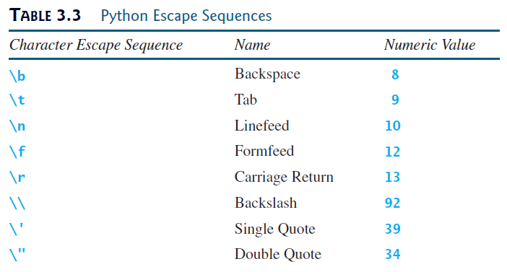
Python Escape Sequences
The \n character is also known as a newline, line break or end-of-line (EOL) character, which signifies the end of a line.
The \f character forces the printer to print from the next page.
The \r character is used to move the cursor to the first position on the same line.
The \f and \r characters are rarely used in this book.
3.3

Slide 35
Python Escape Sequences
Now you can print the previous quoted message using the following statement:
The output:
Note that the symbols \ and " together represent one character.
1
print("He said, \"John's program is easy to read\"")
He said, "John's program is easy to read"
3.3
Notes:
print("He said, \"John's program is easy to read\"")

Slide 36
Python Escape Sequences Example
Newline (\n)
print("ABC\nDEF")
ABC
DEF
Tab (\t)
print("ABC\tDEF")
ABC DEF
Carriage return (\r)
print("ABC\rDEF")
DEF
Backspace (\b)
print("ABC\bDEF")
ABDEF
3.3
Notes:
print("ABC\nDEF")
print("ABC\tDEF")
print("ABC\rDEF")
print("ABC\bDEF")

Slide 37
Python Escape Sequences Example
Double Quote (\")
print("He said \"OK\"")
He said "OK"
Single Quote (\')
print('He said \'OK\'')
He said 'OK'
Backslash (\\)
print("ABC\\DEF")
ABC\DEF
Formfeed (\f)
print("ABC\fDEF")
ABC
DEF
3.3
Notes:
print("He said \"OK\"")
print('He said \'OK\'')
print("ABC\\DEF")
print("ABC\fDEF")

Slide 38
Don't Get Confused
print("nnn\nnnn\n\tnnn\tt\nn\r *\nTest\b\b\b\bAhmad")
nnn
nnn
nnn t
*
Ahmad
print("") # Empty String
print("Line 2")
print('\b\b\b')
print("Line 4")
Line 2
Line 4
3.3
Notes:
print("nnn\nnnn\n\tnnn\tt\nn\r *\nTest\b\b\b\bAhmad")
print("") # Empty String
print("Line 2")
print('\b\b\b')
print("Line 4")

Slide 39
Printing Without The Newline
When you use the print function, it automatically prints a linefeed (\n) to cause the output to advance to the next line.
If you don’t want this to happen after the print function is finished, you can invoke the print function by passing a special argument end = "anyEndingString" using the following syntax:
For example:
print(item, end = "anyEndingString")
1
2
3
4
print("AAA", end = ' ')
print("BBB", end = '')
print("CCC", end = '***')
print("DDD", end = '***')
AAA BBBCCC***DDD***
3.3
Notes:
print(item, end = "anyEndingString")
print("AAA", end = ' ')
print("BBB", end = '')
print("CCC", end = '***')
print("DDD", end = '***')

Slide 40
Printing Without The Newline
Also, You can also use the end argument for printing multiple items using the following syntax:
1
2
3
4
import math
radius = 3
print("The area is", radius * radius * math.pi, end = ' ')
print("and the perimeter is", 2 * radius)
The area is 28.274333882308138 and the perimeter is 6
3.3
Notes:
import math
radius = 3
print("The area is", radius * radius * math.pi, end = ' ')
print("and the perimeter is", 2 * radius)

Slide 41
The str Function
The str function can be used to convert a number into a string.
For example:
>>> s = str(3.4) # Convert a float to string
>>> s
'3.4'
>>> s = str(3) # Convert an integer to string
>>> s
'3'
>>>
3.3
Notes:
s = str(3.4) # Convert a float to string
s
s = str(3) # Convert an integer to string
s

Slide 42
The String Concatenation Operator
You can use the + operator to add two numbers.
Also, the + operator can be used to concatenate two strings.
Here are some examples:
>>> message = "Welcome " + "to " + "Python"
>>> message
'Welcome to Python'
>>> chapterNo = 3
>>> s = "Chapter " + str(chapterNo)
>>> s
'Chapter 3'
>>>
3.3
Notes:
message = "Welcome " + "to " + "Python"
message
chapterNo = 3
s = "Chapter " + str(chapterNo)
s

Slide 43
The String Concatenation Operator
The augmented assignment += operator can also be used for string concatenation.
For example:
>>> message = "Welcome to Python"
>>> message
'Welcome to Python'
>>> message += " and Python is fun"
>>> message
'Welcome to Python and Python is fun'
>>>
3.3
Notes:
message = "Welcome to Python"
message
message += " and Python is fun"
message

Slide 44
Reading Strings From the Console
To read a string from the console, use the input function.
For example, the following code reads three strings from the keyboard:
1
2
3
4
5
6
s1 = input("Enter a string: ")
s2 = input("Enter a string: ")
s3 = input("Enter a string: ")
print("s1 is " + s1)
print("s2 is " + s2)
print("s3 is " + s3)
Enter a string: Welcome <Enter>
Enter a string: to <Enter>
Enter a string: Python <Enter>
s1 is Welcome
s2 is to
s3 is Python
3.3
Notes:
s1 = input("Enter a string: ")
s2 = input("Enter a string: ")
s3 = input("Enter a string: ")
print("s1 is " + s1)
print("s2 is " + s2)
print("s3 is " + s3)

Slide 45
Check Point #2
Write a one statement that is equivalent to the following code:
Solution:
Or
Or
1
2
3
print("Line 1")
print("Line 2")
print("Line 3")
print("Line 1" + "\n" + "Line 2" + "\n" + "Line 3")
print("Line 1\n" + "Line 2\n" + "Line 3")
print("Line 1\nLine 2\nLine 3")
3.3
Notes:
print("Line 1")
print("Line 2")
print("Line 3")
print("Line 1" + "\n" + "Line 2" + "\n" + "Line 3")
print("Line 1\n" + "Line 2\n" + "Line 3")
print("Line 1\nLine 2\nLine 3")

Slide 46
Check Point #3
Show the result of the following code:
Solution:
1
2
3
4
sum = 2 + 3
print(sum)
s = '2' + '3'
print(s)
5
23
3.3
Notes:
sum = 2 + 3
print(sum)
s = '2' + '3'
print(s)

Slide 47
3.4. Case Study: Minimum Number of Coins
Program 2: Compute Change

Slide 48
Compute Change Program 2
Write a program that lets the user enter the amount in decimal representing dollars and cents and output a report listing the monetary equivalent in single dollars, quarters, dimes, nickels, and pennies as shown in the sample run. Your program should report maximum number of dollars, then the maximum number of quarters, and so on, in this order.
Enter an amount in double, e.g., 11.56: 11.56 <Enter>
Your amount 11.56 consists of
11 dollars
2 quarters
0 dimes
1 nickels
1 pennies
3.4

Slide 49
Compute Change Phase 1: Problem-solving
A reminder about U.S. monetary units:
1 dollar = 100 cents (or pennies)
1 quarter = 25 cents
1 dime = 10 cents
1 nickel = 5 cents
So if you need to give someone 42 cents in change, you should give: 0 dollar, 1 quarter, 1 dime, 1 nickel, and 2 pennies.
3.4

Slide 50
Compute Change Phase 1: Problem-solving
First step: UNDERSTAND the problem!
So let us look at an example run:
Is it clear what the problem is asking of us?
Make sure you understand the question before starting
Enter an amount in double, e.g., 11.56: 11.56 <Enter>
Your amount 11.56 consists of
11 dollars
2 quarters
0 dimes
1 nickels
1 pennies
3.4

Slide 51
Compute Change Phase 1: Problem-solving
Design your algorithm:
Prompt the user to enter the amount as a decimal number.
amount = eval(input(“Message…”))
Example: 11.56
Convert this amount into cents (multiply by 100)
totalCents = int(amount * 100)
Example: 11.56 * 100 = 1156
3.4

Slide 52
Compute Change Phase 1: Problem-solving
Design your algorithm:
Get the total number of dollars by now dividing by 100. And get remaining cents by using totalCents % 100.
totalDollars = totalCents // 100
Example: 1156 // 100 = 11
remainingCents = totalCents % 100
Example: 1156 % 100 = 56
3.4

Slide 53
Compute Change Phase 1: Problem-solving
Design your algorithm:
Get the total # of quarters by dividing remainingCents by 25. And then recalculate remainingCents.
totalQuarters = remainingCents // 25
Example: 56 // 25 = 2
remainingCents = remainingCents % 25
Example: 56 % 25 = 6
3.4

Slide 54
Compute Change Phase 1: Problem-solving
Design your algorithm:
Get the total # of dimes by dividing remainingCentsby 10. And then recalculate remainingCents.
totalDimes = remainingCents // 10
Example: 6 // 10 = 0
remainingCents = remainingCents % 10
Example: 6 % 10 = 6
So nothing changed at this step. remainingCents is still 6.
3.4

Slide 55
Compute Change Phase 1: Problem-solving
Design your algorithm:
Get the total # of nickels by dividing remainingCents by 5. And then recalculate remainingCents.
totalnickels = remainingCents // 5
Example: 6 // 5 = 1
remainingCents = remainingCents % 5
Example: 6 % 5 = 1
3.4

Slide 56
Compute Change Phase 1: Problem-solving
Design your algorithm:
The value stored in remainingCents is the number of pennies left over.
Example: remainingCents = 1
Display the result.
Example: Dollars = 11, Quarters = 2, Dimes = 0, Nickels = 1, Pennies = 1
3.4

Slide 57
Compute Change Phase 2: Implementation
LISTING 3.4 ComputeChange.py
1
2
3
4
5
6
7
8
9
10
11
12
13
14
15
16
17
18
# Receive the amount
amount = eval(input("Enter an amount in double, e.g., 11.56: "))
# Convert the amount to cents
remainingAmount = int(amount * 100)
# Find the number of one dollars
numberOfOneDollars = remainingAmount // 100
remainingAmount = remainingAmount % 100
# Find the number of quarters in the remaining amount
numberOfQuarters = remainingAmount // 25
remainingAmount = remainingAmount % 25
# Find the number of dimes in the remaining amount
numberOfDimes = remainingAmount // 10
remainingAmount = remainingAmount % 10
Run
3.4
Notes:
# Receive the amount
amount = eval(input("Enter an amount in double, e.g., 11.56: "))
# Convert the amount to cents
remainingAmount = int(amount * 100)
# Find the number of one dollars
numberOfOneDollars = remainingAmount // 100
remainingAmount = remainingAmount % 100
# Find the number of quarters in the remaining amount
numberOfQuarters = remainingAmount // 25
remainingAmount = remainingAmount % 25
# Find the number of dimes in the remaining amount
numberOfDimes = remainingAmount // 10
remainingAmount = remainingAmount % 10
# Find the number of nickels in the remaining amount
numberOfNickels = remainingAmount // 5
remainingAmount = remainingAmount % 5
# Find the number of pennies in the remaining amount
numberOfPennies = remainingAmount
# Display results
print("Your amount", amount, "consists of\n",
"\t", numberOfOneDollars, "dollars\n",
"\t", numberOfQuarters, "quarters\n",
"\t", numberOfDimes, "dimes\n",
"\t", numberOfNickels, "nickels\n",
"\t", numberOfPennies, "pennies")

Slide 58
Compute Change Phase 2: Implementation
LISTING 3.4 ComputeChange.py
19
20
21
22
23
24
25
26
27
28
29
30
31
32
# Find the number of nickels in the remaining amount
numberOfNickels = remainingAmount // 5
remainingAmount = remainingAmount % 5
# Find the number of pennies in the remaining amount
numberOfPennies = remainingAmount
# Display results
print("Your amount", amount, "consists of\n",
"\t", numberOfOneDollars, "dollars\n",
"\t", numberOfQuarters, "quarters\n",
"\t", numberOfDimes, "dimes\n",
"\t", numberOfNickels, "nickels\n",
"\t", numberOfPennies, "pennies")
Run
3.4
Notes:
# Receive the amount
amount = eval(input("Enter an amount in double, e.g., 11.56: "))
# Convert the amount to cents
remainingAmount = int(amount * 100)
# Find the number of one dollars
numberOfOneDollars = remainingAmount // 100
remainingAmount = remainingAmount % 100
# Find the number of quarters in the remaining amount
numberOfQuarters = remainingAmount // 25
remainingAmount = remainingAmount % 25
# Find the number of dimes in the remaining amount
numberOfDimes = remainingAmount // 10
remainingAmount = remainingAmount % 10
# Find the number of nickels in the remaining amount
numberOfNickels = remainingAmount // 5
remainingAmount = remainingAmount % 5
# Find the number of pennies in the remaining amount
numberOfPennies = remainingAmount
# Display results
print("Your amount", amount, "consists of\n",
"\t", numberOfOneDollars, "dollars\n",
"\t", numberOfQuarters, "quarters\n",
"\t", numberOfDimes, "dimes\n",
"\t", numberOfNickels, "nickels\n",
"\t", numberOfPennies, "pennies")

Slide 59
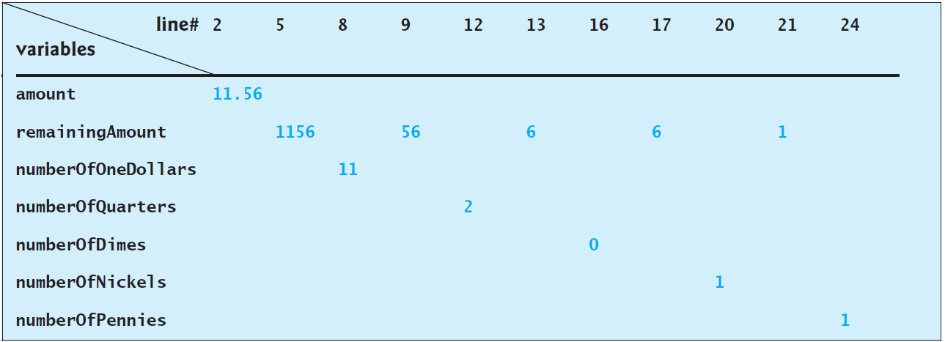
Compute Change Trace The Program Execution
Enter an amount in double, e.g., 11.56: 11.56 <Enter>
Your amount 11.56 consists of
11 dollars
2 quarters
0 dimes
1 nickels
1 pennies
3.4

Slide 60
Compute Change Discussion
The variable amount stores the amount entered from the console (line 2). This variable is not changed, because the amount has to be used at the end of the program to display the results.
The program introduces the variable remainingAmount (line 5) to store the changing remainingAmount.
The variable amount is a float representing dollars and cents.
It is converted to an integer variable remainingAmount, which represents all the cents. For instance, if amount is 11.56, then the initial remainingAmount is 1156. 1156 // 100 is 11 (line 8).
The remainder operator obtains the remainder of the division. So, 1156 % 100 is 56 (line 9).
3.4

Slide 61
Compute Change Discussion
The program extracts the maximum number of quarters from remainingAmount and obtains a new remainingAmount (lines 12–13).
Continuing the same process, the program finds the maximum number of dimes, nickels, and pennies in the remaining amount.
As shown in the sample run, 0 dimes, 1 nickels, and 1 pennies are displayed in the result. It would be better not to display 0 dimes, and to display 1 nickel and 1 penny using the singular forms of the words. You will learn how to use selection statements to modify this program in the next chapter.
3.4

Slide 62
Caution
One serious problem with this example is the possible loss of precision when converting a float amount to the integer remainingAmount.
This could lead to an inaccurate result.
If you try to enter the amount 10.03, 10.03 * 100 might be 1002.9999999999999.
You will find that the program displays 10 dollars and 2 pennies.
To fix the problem, enter the amount as an integer value representing cents (see Exercise 3.8).
3.4

Slide 63
3.6. Formatting Numbers and Strings
Formatting Floating-Point Numbers
Formatting as a Percentage
Justifying Format
Formatting Integers
Formatting Strings
Frequently Used Specifiers
Problem 3: Print a Table
Check Point #4 - #5

Slide 64
Formatting Numbers and Strings
When printing float values, often we do not need or want all the decimals.
In fact, often we want only two (for money)!
In Chapter 2 and this chapter, we have learned that you can get two digits after the decimal as follows:
However, the format is still not correct. There should be two digits after the decimal point like 16.40 rather than 16.4.
1
2
3
4
5
x = 16.404674
x = int(x * 100) / 100 # x => 1640 / 100 = 16.4
print("x is", x) # output: x is 16.4
# Or we can use the round(num, digit) function
print("x is", round(x, 2)) # output: x is 16.4
3.6
Notes:
x = 16.404674
x = int(x * 100) / 100 # x => 1640 / 100 = 16.4
print("x is", x) # output: x is 16.4
# Or we can use the round(num, digit) function
print("x is", round(x, 2)) # output: x is 16.4

Slide 65
Formatting Numbers and Strings
You can use the format function to format a number or a string and return the result as a string.
How to print 16.404674 with only two decimals?
The syntax to invoke format function is
where item is a number or a string and format-specifier is a string that specifies how the item is formatted.
The function returns a string.
1
2
x = 16.404674
print("x is", format(x, ".2f")) # print: x is 16.40
format(item, format-specifier)
3.6
Notes:
x = 16.404674
print("x is", format(x, ".2f")) # print: x is 16.40

Slide 66
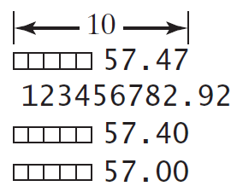
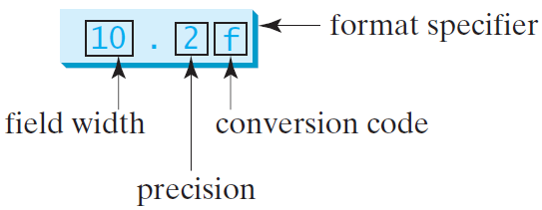
Formatting Floating-Point Numbers
If the item is a float value, you can use the specifier to give the width and precision of the format in the form of width.precisionf. Here, width specifies the width of the resulting string, precision specifies the number of digits after the decimal point, and f is called the conversion code, which sets the formatting for floating point numbers. For example:
1
2
3
4
print(format(57.467657, "10.2f"))
print(format(123456782.923, "10.2f"))
print(format(57.4, "10.2f"))
print(format(57, "10.2f"))
A square box □ denotes a blank space.
Note that the decimal point is counted as one space.
3.6
Notes:
print(format(57.467657, "10.2f"))
print(format(12345678.923, "10.2f"))
print(format(57.4, "10.2f"))
print(format(57, "10.2f"))

Slide 67
Formatting Floating-Point Numbers
The format("10.2f") function formats the number into a string whose width is 10, including a decimal point and two digits after the point.
The number is rounded to two decimal places.
Thus there are seven digits allocated before the decimal point.
If there are fewer than seven digits before the decimal point, spaces are inserted before the number.
If there are more than seven digits before the decimal point, the number’s width is automatically increased.
For example, format(12345678.923, "10.2f") returns 12345678.92, which has a width of 11.
3.6

Slide 68
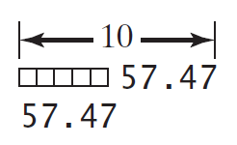
Formatting Floating-Point Numbers
You can omit the width specifier. If so, it defaults to 0.
In this case, the width is automatically set to the size needed for formatting the number.
For example:
1
2
print(format(57.467657, "10.2f"))
print(format(57.467657, ".2f"))
3.6
Notes:
print(format(57.467657, "10.2f"))
print(format(57.467657, ".2f"))

Slide 69
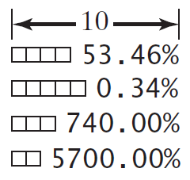
Formatting as a Percentage
You can use the conversion code % to format a number as a percentage.
For example:
The format 10.2% causes the number to be multiplied by 100 and displayed with a % sign following it.
The total width includes the % sign counted as one space.
1
2
3
4
print(format(0.53457, "10.2%"))
print(format(0.0033923, "10.2%"))
print(format(7.4, "10.2%"))
print(format(57, "10.2%"))
3.6
Notes:
print(format(0.53457, "10.2%"))
print(format(0.0033923, "10.2%"))
print(format(7.4, "10.2%"))
print(format(57, "10.2%"))

Slide 70
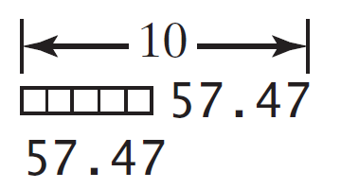
Justifying Format
By default, the format of a number is right justified.
You can put the symbol < in the format specifier to specify that the item be left-justified in the resulting format within the specified width.
For example:
1
2
print(format(57.467657, "10.2f"))
print(format(57.467657, "<10.2f"))
3.6
Notes:
print(format(57.467657, "10.2f"))
print(format(57.467657, "<10.2f"))

Slide 71
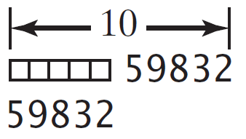
Formatting Integers
The conversion code d can be used to format an integer in decimal.
You can specify a width for the conversion.
For example:
1
2
print(format(59832, "10d"))
print(format(59832, "<10d"))
3.6
Notes:
print(format(59832, "10d"))
print(format(59832, "<10d"))

Slide 72
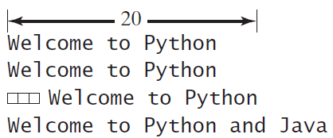
Formatting Strings
You can use the conversion code s to format a string with a specified width.
For example:
The format specifier 20s specifies that the string is formatted within a width of 20.
By default, a string is left justified.
To right-justify it, put the symbol > in the format specifier. If the string is longer than the specified width, the width is automatically increased to fit the string.
1
2
3
4
print(format("Welcome to Python", "20s"))
print(format("Welcome to Python", "<20s"))
print(format("Welcome to Python", ">20s"))
print(format("Welcome to Python and Java", ">20s"))
3.6
Notes:
print(format("Welcome to Python", "20s"))
print(format("Welcome to Python", "<20s"))
print(format("Welcome to Python", ">20s"))
print(format("Welcome to Python and Java", ">20s"))

Slide 73
Frequently Used Specifiers
3.6

Slide 74
Note
The format function uses the built-in round function when dealing with floating-point numbers.
print(format(123.426, "10.2f"))
123.43
print(round(123.426, 2))
123.43
print(format(123.424, "10.2f"))
123.42
print(round(123.424, 2))
123.42
print(format(12.678, ".0f"))
13
print(round(12.678))
13
print(format(12.378, ".0f"))
12
print(round(12.378))
12
3.6

Slide 75
Note
The behavior of round() for floats can be surprising.
For example: round(2.675, 2) gives 2.67 instead of the expected 2.68.
This is not a bug: it’s a result of the fact that most decimal fractions can’t be represented exactly as a float.
3.6

Slide 76
Print a Table Program 3
Write a program that displays the following table as shown in the sample run:
---------------------------------
x| x^2 √x
---------------------------------
5| 25.00 2.24
500| 250000.00 22.36
20| 400.00 4.47
3000| 9000000.00 54.77
---------------------------------
3.6

Slide 77
Print a Table Implementation A
PrintTableA.py
1
2
3
4
5
6
7
8
9
10
11
12
13
14
import math
# The header of the table
print("---------------------------------")
print(format("x", ">5s") + '|', format("x^2", "12s"), format("√x", "10s"))
print("---------------------------------")
print(format(5, ">5d") + '|', format(5 ** 2, "<12.2f"), format(math.sqrt(5), "<10.2f"))
print(format(500, ">5d") + '|', format(500 ** 2, "<12.2f"), format(math.sqrt(500), "<10.2f"))
print(format(20, ">5d") + '|', format(20 ** 2, "<12.2f"), format(math.sqrt(20), "<10.2f"))
print(format(3000, ">5d") + '|', format(3000 ** 2, "<12.2f"), format(math.sqrt(3000), "<10.2f"))
# The footer of the table
print("---------------------------------")
Run
Let us see another implementation of the same problem in the next slide. Then we will discuss which one is the best.
3.6
Notes:
import math
# The header of the table
print("---------------------------------")
print(format("x", ">5s") + '|', format("x^2", "12s"), format("√x", "10s"))
print("---------------------------------")
print(format(5, ">5d") + '|', format(5 ** 2, "<12.2f"), format(math.sqrt(5), "<10.2f"))
print(format(500, ">5d") + '|', format(500 ** 2, "<12.2f"), format(math.sqrt(500), "<10.2f"))
print(format(20, ">5d") + '|', format(20 ** 2, "<12.2f"), format(math.sqrt(20), "<10.2f"))
print(format(3000, ">5d") + '|', format(3000 ** 2, "<12.2f"), format(math.sqrt(3000), "<10.2f"))
# The footer of the table
print("---------------------------------")

Slide 78
Print a Table Implementation B
PrintTableB.py
1
2
3
4
5
6
7
8
9
10
11
12
13
14
15
16
17
18
19
20
21
22
23
24
25
26
import math
SEPARATOR = '|' # a constant to represent the separator between the first and second columns
FORMAT_1 = ">5d" # a constant to represent the Specifier for the first column format
FORMAT_2 = "<12.2f" # a constant to represent the Specifier for the second column format
FORMAT_3 = "<10.2f" # a constant to represent the Specifier for the first third format
# The header of the table
print("---------------------------------")
print(format("x", ">5s") + SEPARATOR, format("x^2", "12s"), format("√x", "10s"))
print("---------------------------------")
x = 5 # this variable stores the value of x that will be included with the next calculations
print(format(x, FORMAT_1) + SEPARATOR, format(x ** 2, FORMAT_2), format(math.sqrt(x), FORMAT_3))
x = 500 # change the value, so we don't need to change the previous statement to apply the change
print(format(x, FORMAT_1) + SEPARATOR, format(x ** 2, FORMAT_2), format(math.sqrt(x), FORMAT_3))
x = 20 # change the value, so we don't need to change the previous statement to apply the change
print(format(x, FORMAT_1) + SEPARATOR, format(x ** 2, FORMAT_2), format(math.sqrt(x), FORMAT_3))
x = 3000 # change the value, so we don't need to change the previous statement to apply the change
print(format(x, FORMAT_1) + SEPARATOR, format(x ** 2, FORMAT_2), format(math.sqrt(x), FORMAT_3))
# The footer of the table
print("---------------------------------")
Run
3.6
Notes:
import math
SEPARATOR = '|' # a constant to represent the separator between the first and second columns
FORMAT_1 = ">5d" # a constant to represent the Specifier for the first column format
FORMAT_2 = "<12.2f" # a constant to represent the Specifier for the second column format
FORMAT_3 = "<10.2f" # a constant to represent the Specifier for the first third format
# The header of the table
print("---------------------------------")
print(format("x", ">5s") + SEPARATOR, format("x^2", "12s"), format("√x", "10s"))
print("---------------------------------")
x = 5 # this variable stores the value of x that will be included with the next calculations
print(format(x, FORMAT_1) + SEPARATOR, format(x ** 2, FORMAT_2), format(math.sqrt(x), FORMAT_3))
x = 500 # change the value, so we don't need to change the previous statement to apply the change
print(format(x, FORMAT_1) + SEPARATOR, format(x ** 2, FORMAT_2), format(math.sqrt(x), FORMAT_3))
x = 20 # change the value, so we don't need to change the previous statement to apply the change
print(format(x, FORMAT_1) + SEPARATOR, format(x ** 2, FORMAT_2), format(math.sqrt(x), FORMAT_3))
x = 3000 # change the value, so we don't need to change the previous statement to apply the change
print(format(x, FORMAT_1) + SEPARATOR, format(x ** 2, FORMAT_2), format(math.sqrt(x), FORMAT_3))
# The footer of the table
print("---------------------------------")

Slide 79
Print a Table Discussion
Implementation A and Implementation B are both correct.
However, Implementation B is better than Implementation A because it requires fewer modifications on the code when you want to change the formats of the columns and the values of x.
In other words, Implementation B is flexible.
3.6

Slide 80
Check Point #4
Show the printout of the following statements:
print(format(57.467657, "9.3f"))
57.468
print(format(12345678.923, "9.1f"))
12345678.9
print(format(57.4, ".2f"))
57.40
print(format(57.4, "10.2f"))
57.40
3.6
Notes:
print(format(57.467657, "9.3f"))
print(format(12345678.923, "9.1f"))
print(format(57.4, ".2f"))
print(format(57.4, "10.2f"))

Slide 81
Check Point #5
‏‏‎
‏‏‎
‏‏‎
‏‏‎
‏‏‎
‏‏‎
Show the printout of the following statements:
print(format("Programming is fun", "25s"))
Programming is fun⠀⠀⠀⠀⠀⠀⠀
print(format("Programming is fun", "<25s"))
Programming is fun⠀⠀⠀⠀⠀⠀⠀
print(format("Programming is fun", ">25s"))
⠀⠀⠀⠀⠀⠀⠀ Programming is fun
3.6
Notes:
print(format("Programming is fun", "25s"))
print(format("Programming is fun", “<25s"))
print(format("Programming is fun", “>25s"))

Slide 82
End
Test Questions
Programming Exercises

Slide 83
Test Questions
Do the test questions for this chapter online at https://liveexample-ppe.pearsoncmg.com/selftest/selftestpy?chapter=3

Slide 84
Programming Exercises
Page 85 – 88:
3.1 - 3.5
3.8 - 3.9
3.11
Lab #5

